Slide 1

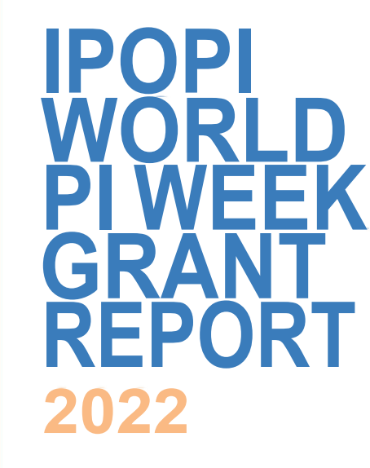

IPOPI World PI Week 2023
Grant Programme
2023

Slide 2

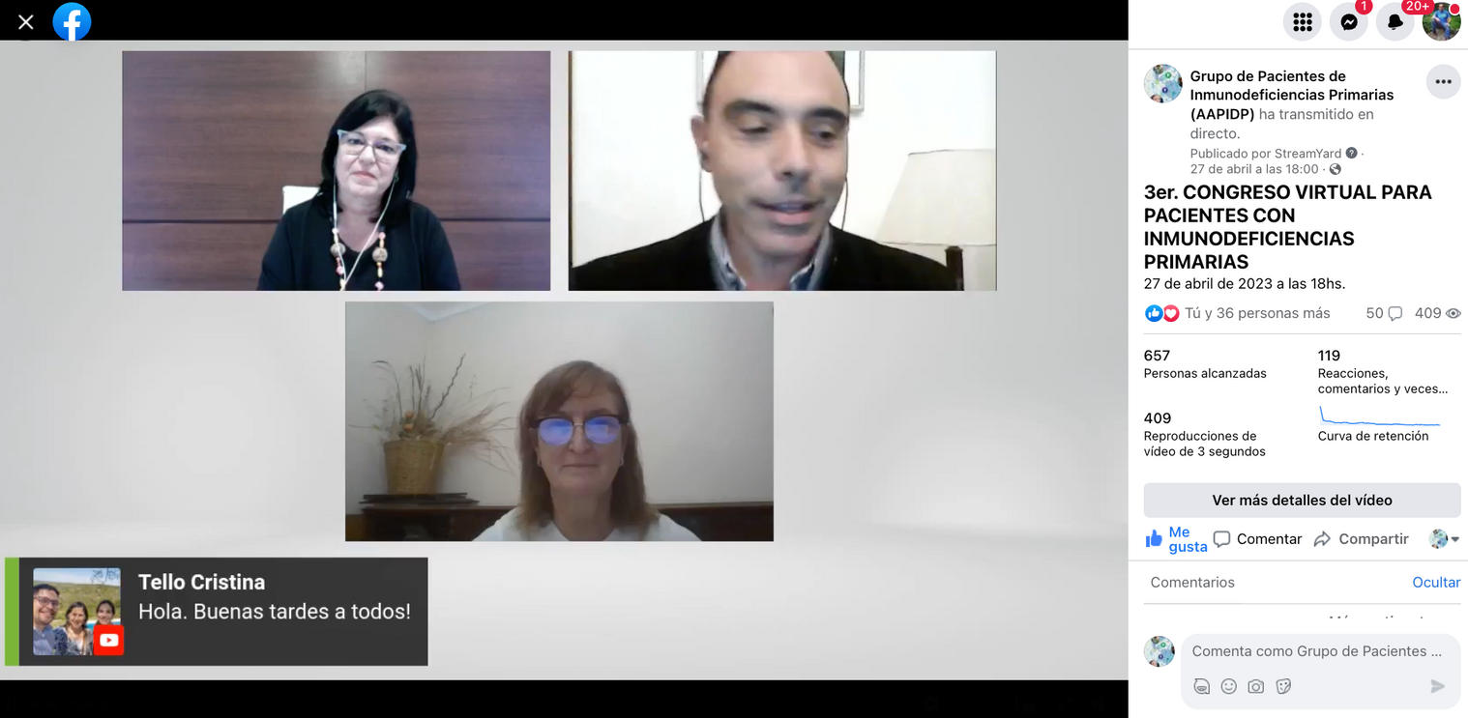
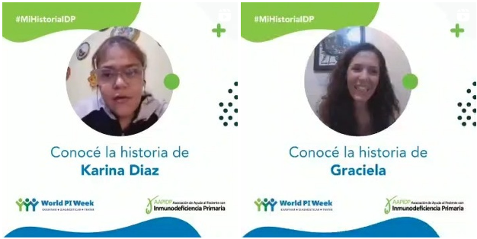
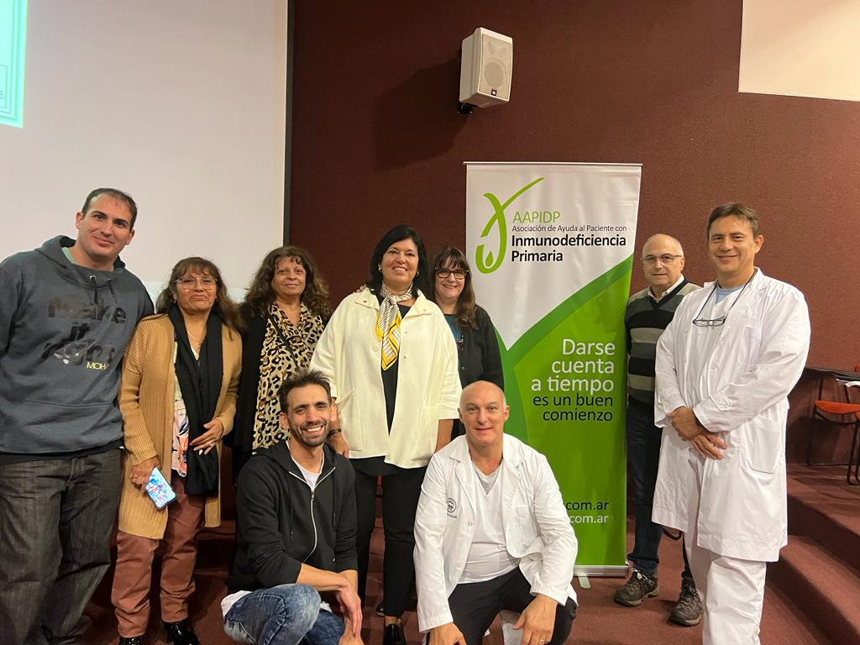
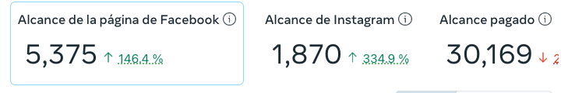
Argentina
Asociación Ayuda al Paciente con Inmunodeficiencia Primaria (AAPIDP)
Projects:
Held a meeting for patients, nurses and doctors in Pedro Elizalde Hospital, in Buenos Aires.
3rd Virtual Congress for Patients and Families with PID, with two educational lectures and one advocacy lecture about access to treatment. Youtube: 134 reproductions. Facebook: 486 reproductions.
Strong campaign on social media, during the whole week, reinforcing the right to health, early diagnosis and adequate treatment and care in a timely manner. Shared personal stories-videos about how to leave with PID.

Slide 3



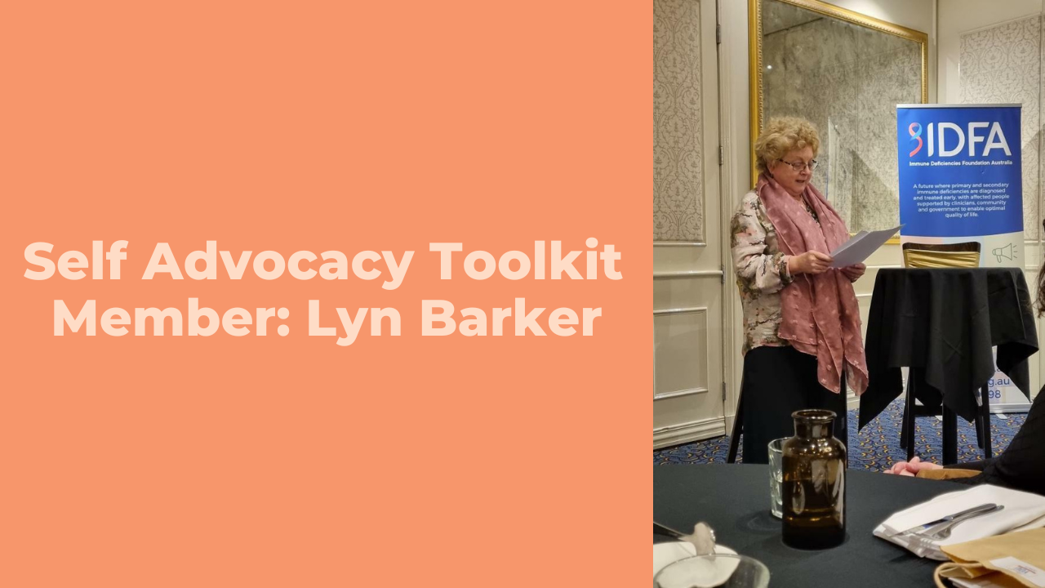
Australia
Immune Deficiencies Foundation Australia (IDFA)
Projects:
IDFA engaged with members to produce three promotional videos to highlight the Self Advocacy Toolkit.
Additionally, Christine Jeffery from Blue Wren Advocacy was engaged as the co-creator of the tools and an instructional video was developed with her to provide further insight into the benefits of the tools. The project also included the development of a landing page for the toolkit and videos to be available on.
These videos highlighted the members´ ability to access these tools and advocate for those living with a PI. An educational webinar was hosted to delve deeper into the tools and how they could help their members. These videos will be used for ongoing promotional purposes at their in-person and online events, during advocacy campaigns and on all their online platforms (website, Facebook, Instagram, LinkedIn etc.).

Slide 4

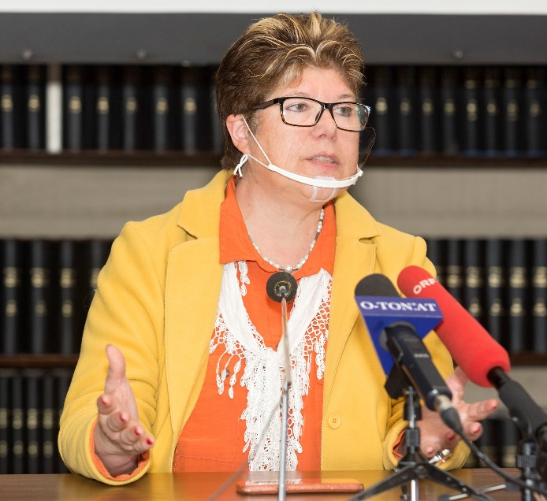
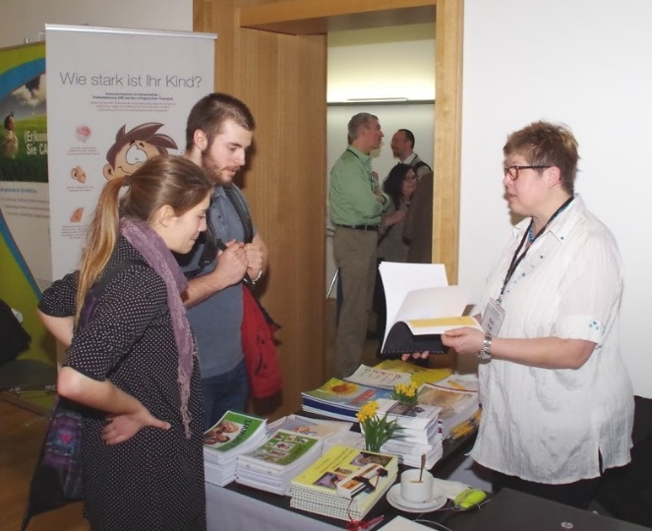
Austria
Ö S P I D
Projects:
Expanded the reach of their self-discovery campaigns for new PID. Started an Austria-wide "poster campaign". Designed a poster that should be an eye-catcher for patients who have not yet been diagnosed - text: "See your doctor more often than your Family". With QR codes, the poster gave direct access to their homepage and key knowledge on PID diagnosis. They sent these posters to all hospitals in Austria. As a result, people called them, asked about PID, and some new patients were even able to find their PID diagnosis.
Sent an info sheet about PID, ÖSPID and the problems for undiagnosed people with PID to a large number of radio and television stations and newspaper editors.
Set up information tables in some hospitals for discussions and problem-solving to diagnose PID. They were able to discuss the problem and a faster way to diagnosis not only with patients but also with doctors

Slide 5
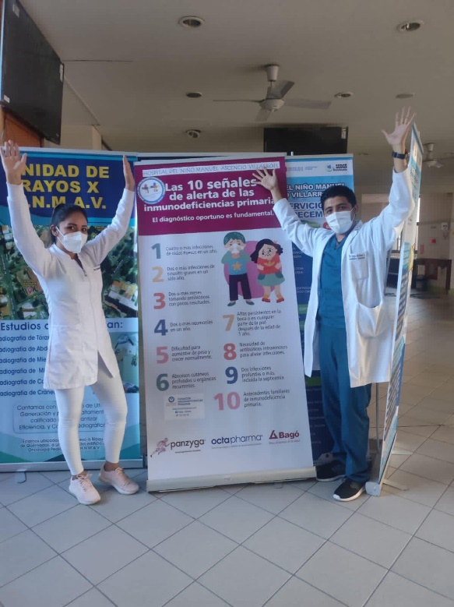
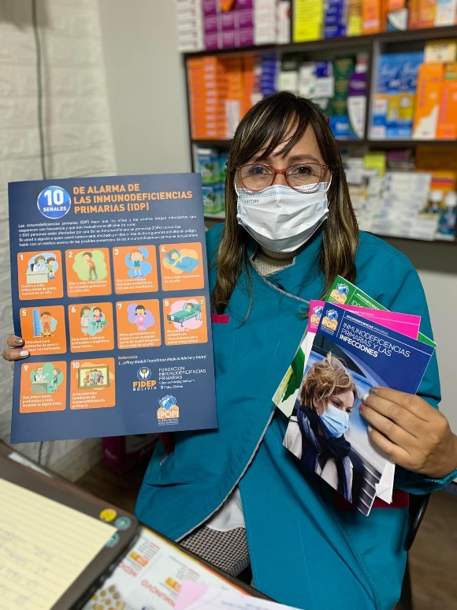
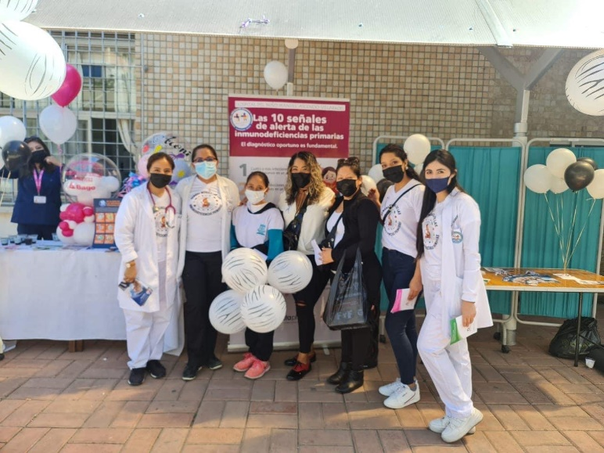
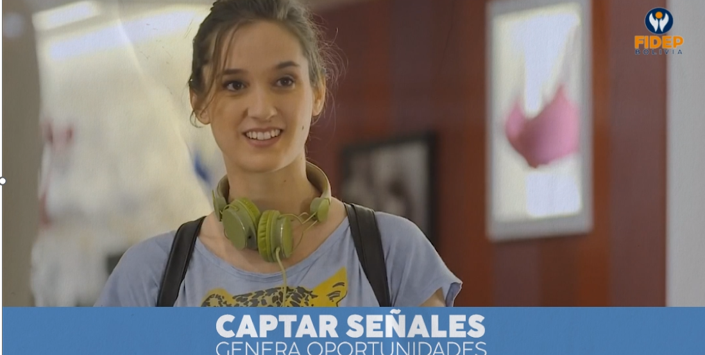
Bolivia
FIDEP BOLIVIA
Project: Awareness Campaign World PI Week ¨DATE CUENTA¨
Developed a virtual and also face-to-face campaign.
Made four informative videos about PIDs, as well as visited doctors to give them books and a poster of the 10 warning signs.
In a children's Hospital in the city of Cochabamba an awareness campaign was carried out informing and giving away material on PIDs.
The slogan “Date Cuenta” was used.

Slide 6
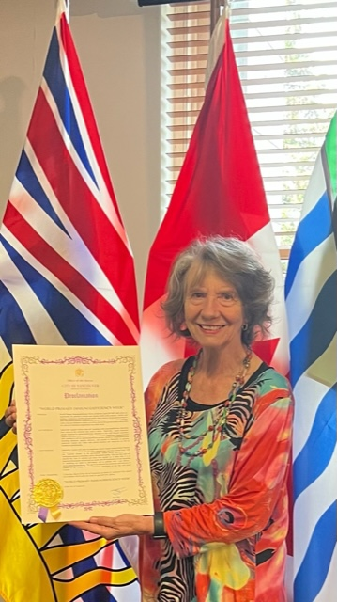
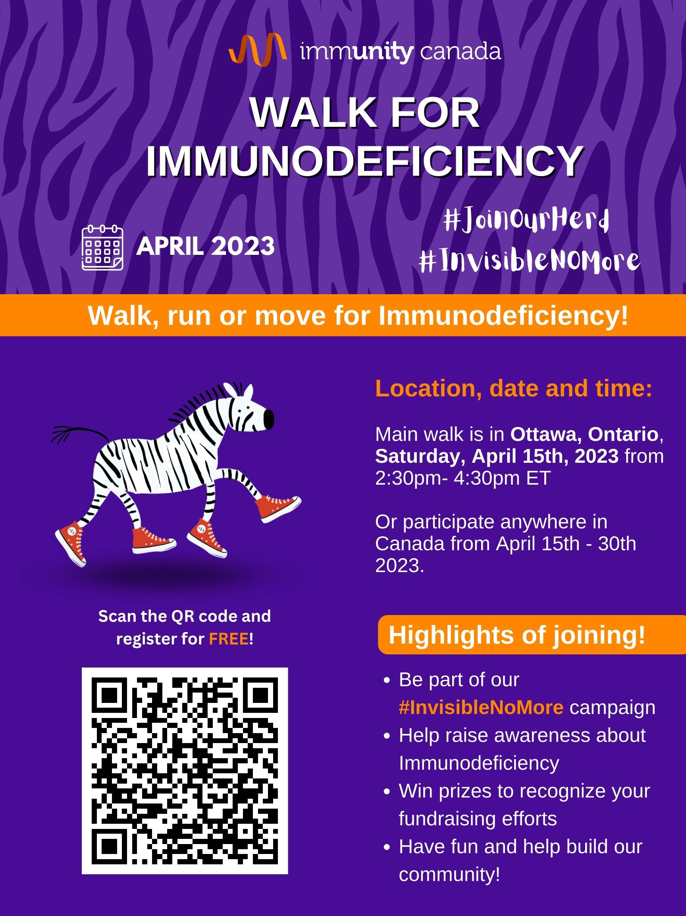
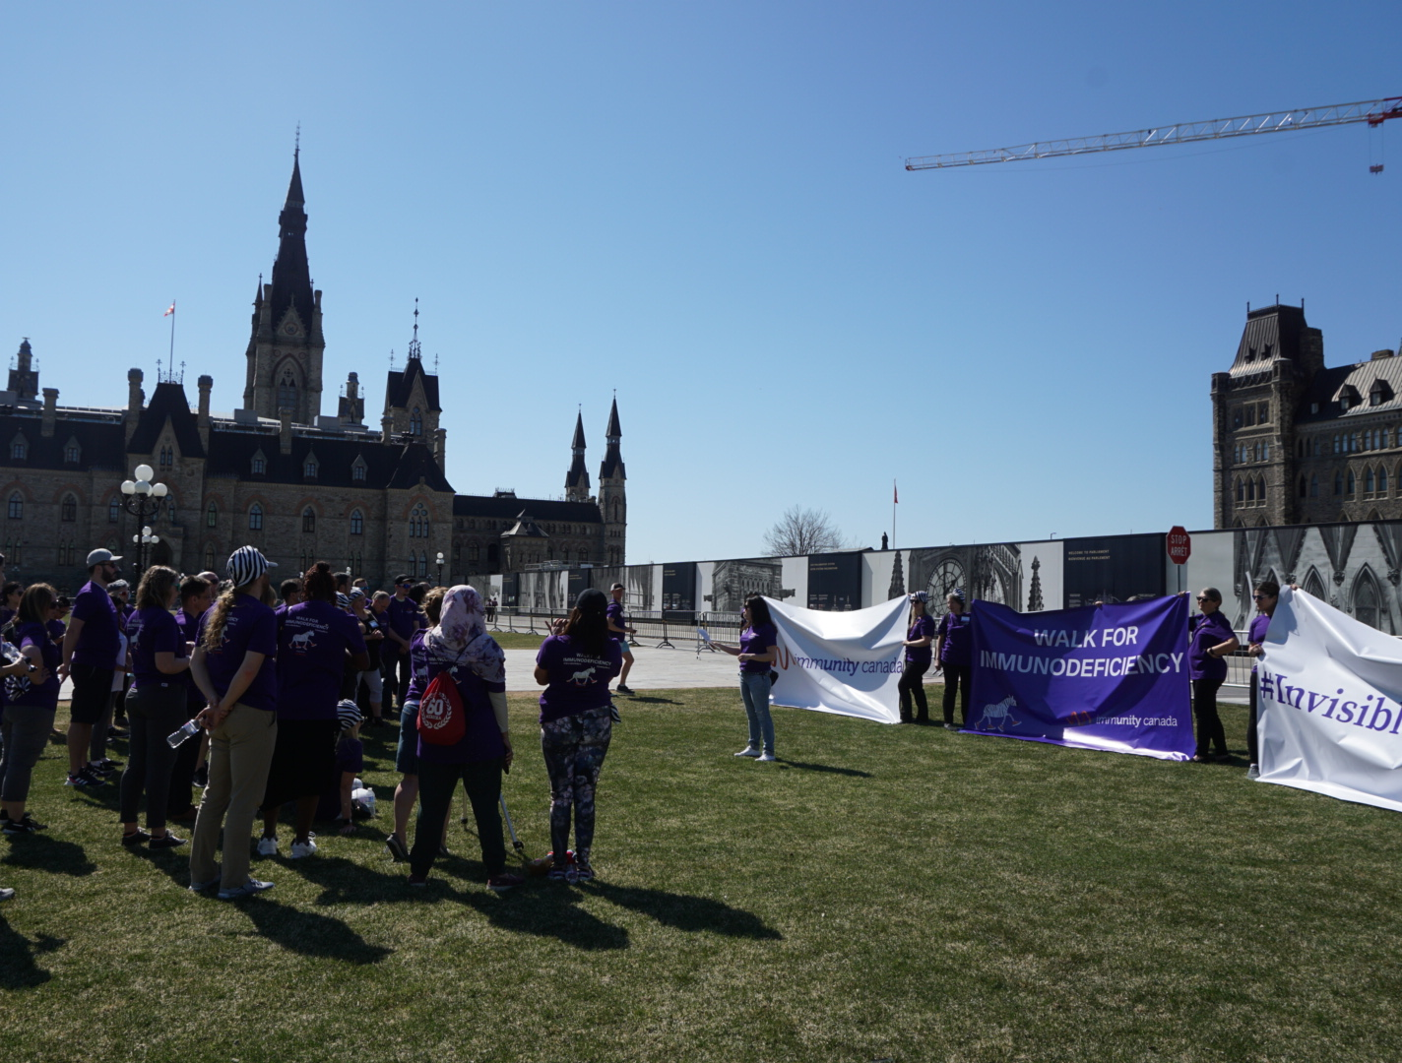

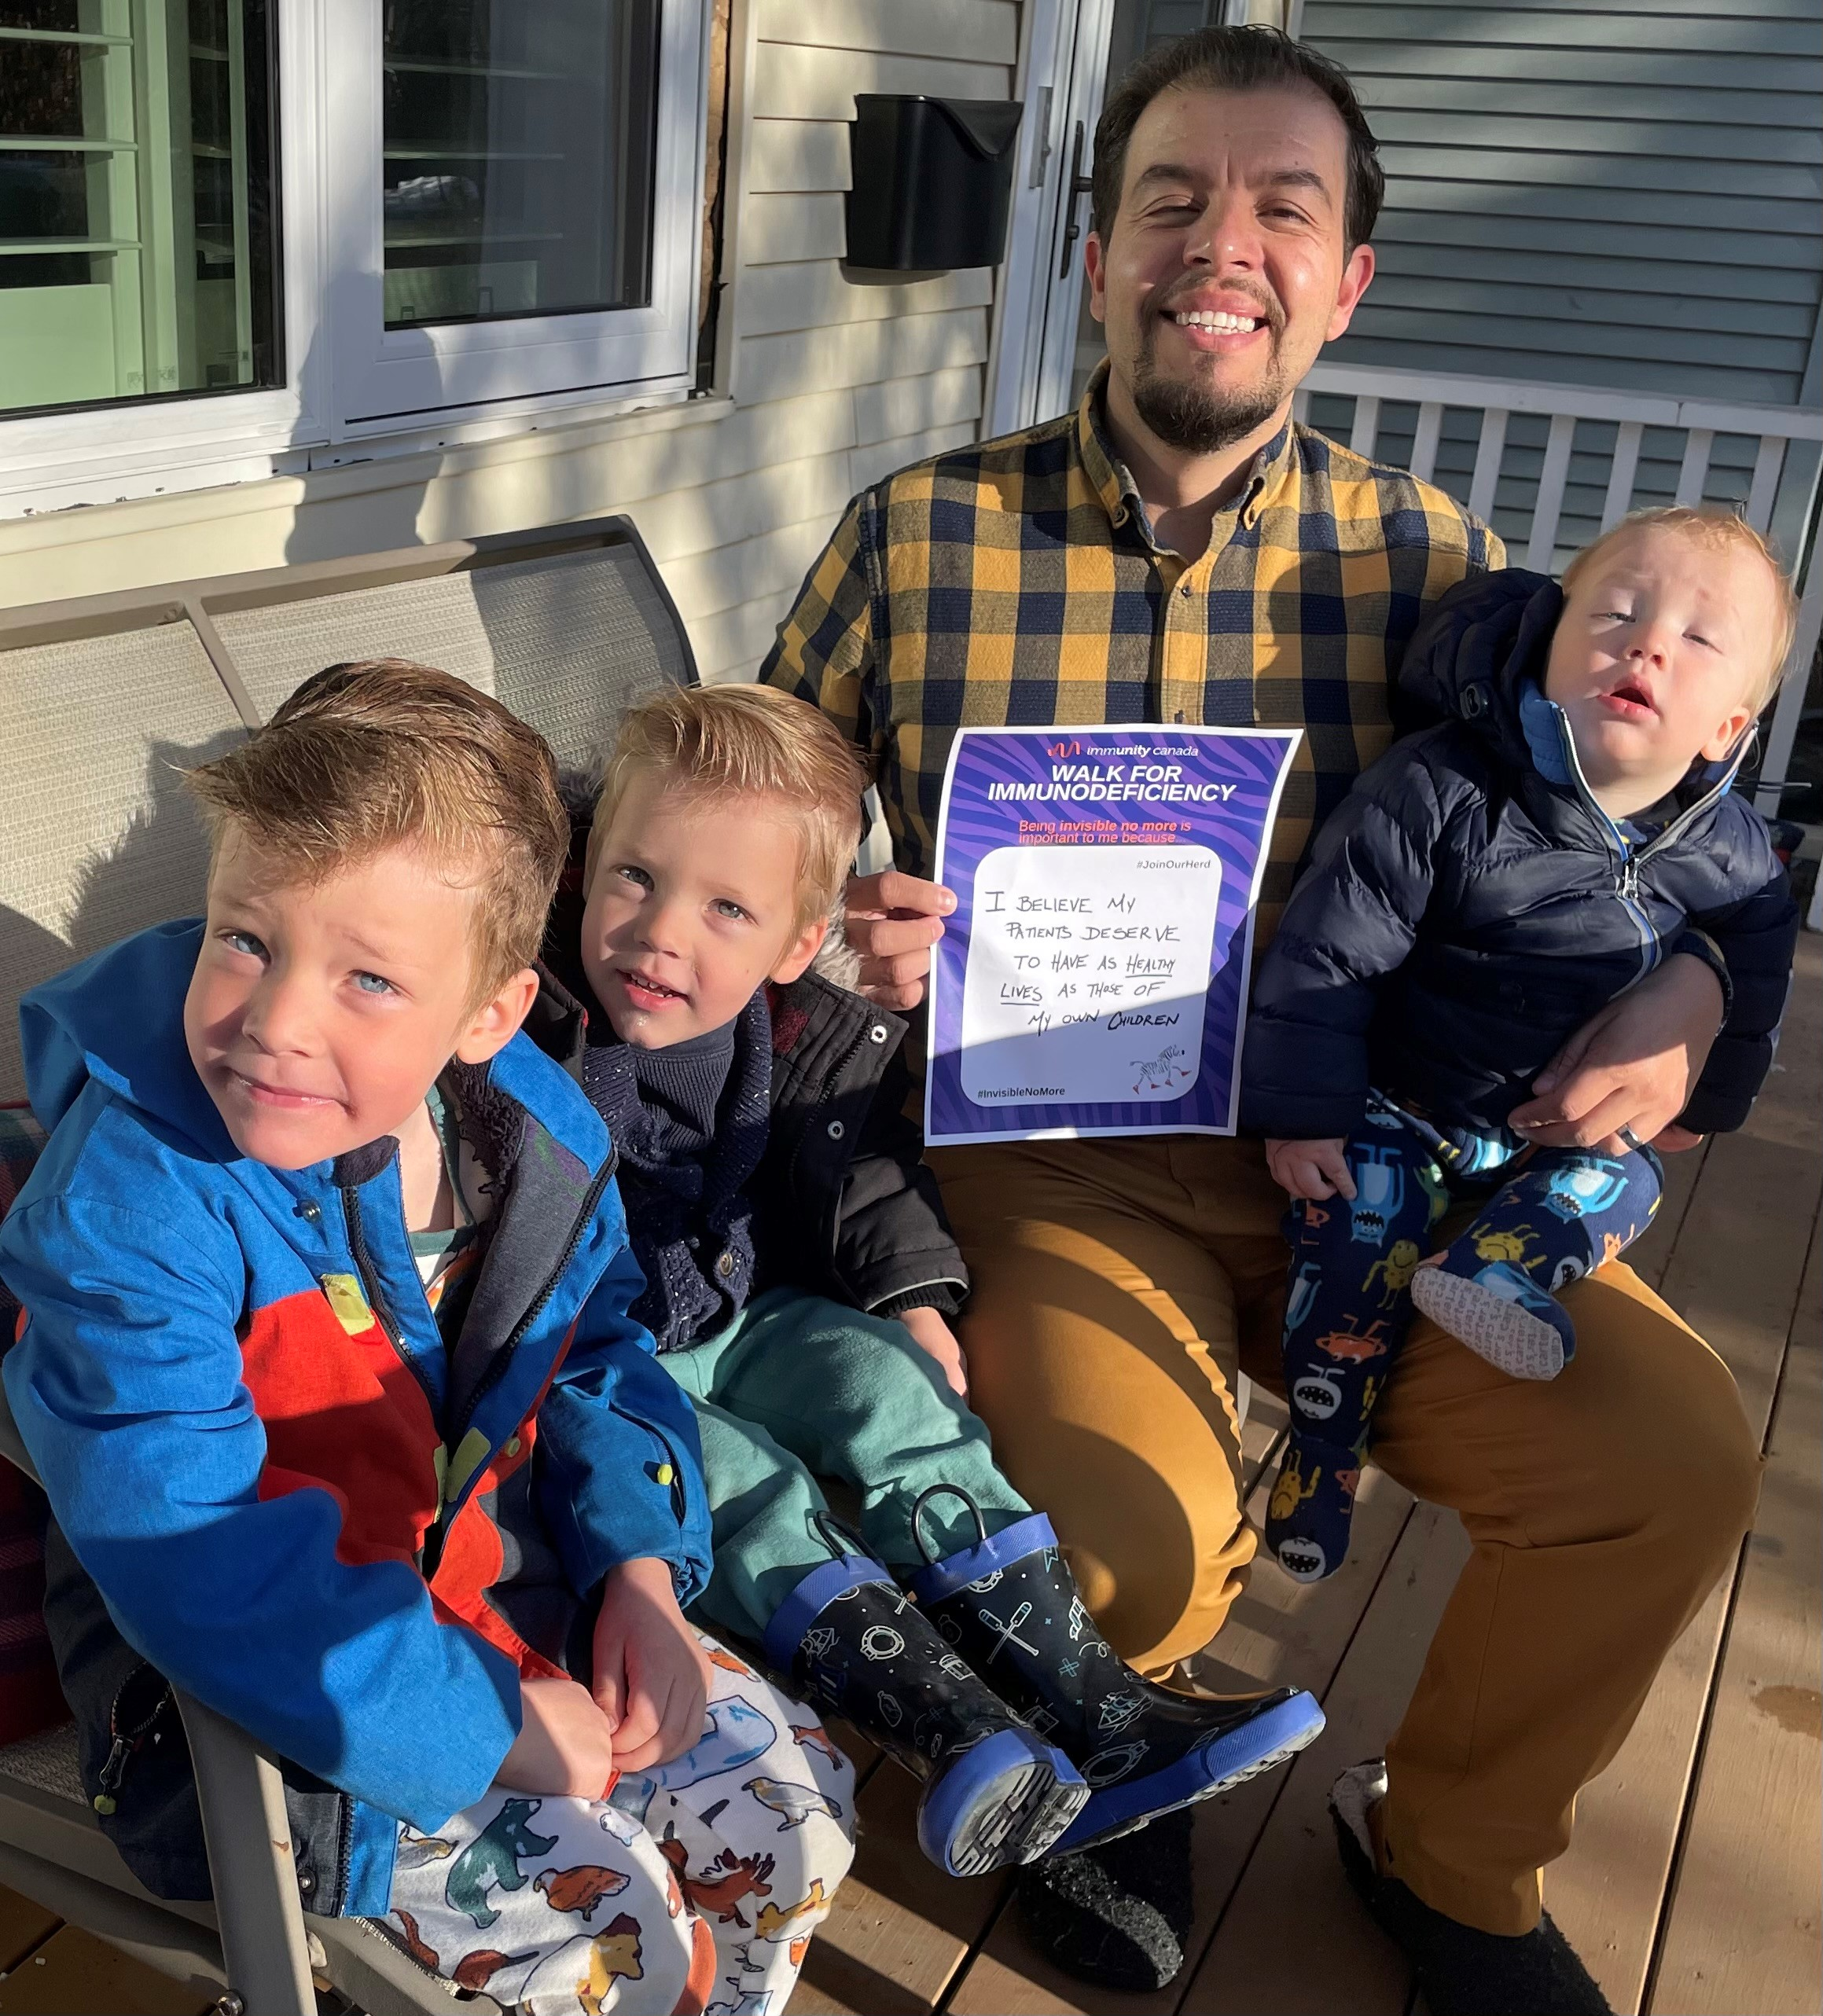
Canada
ImmUnity Canada
Project: Invisible No More Campaign
Over 100 participants walked nationally
Mass walk in Ottawa and submission of campaign messages shared online by patients and health care professionals
PI Week Proclamations in 6 cities
Meeting between MP and patient
Raised over CAD$28,000 and increase in number of new supporters

Slide 7
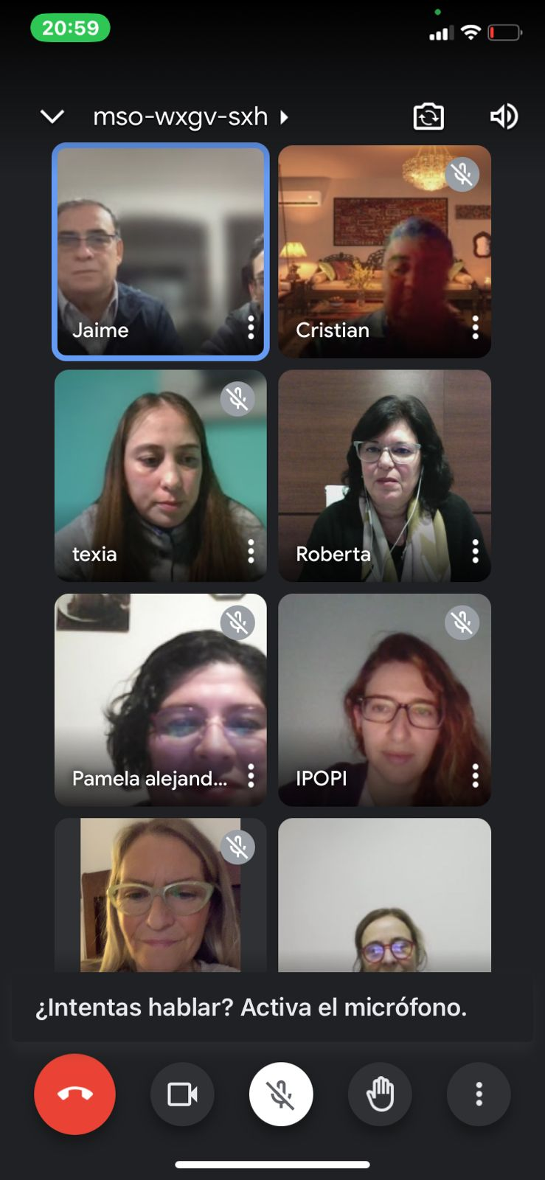
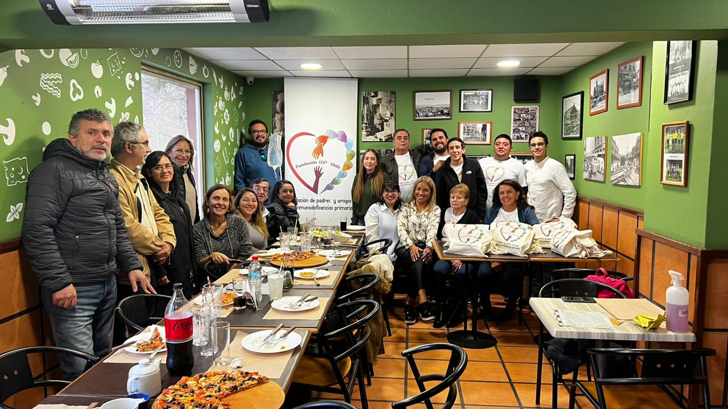
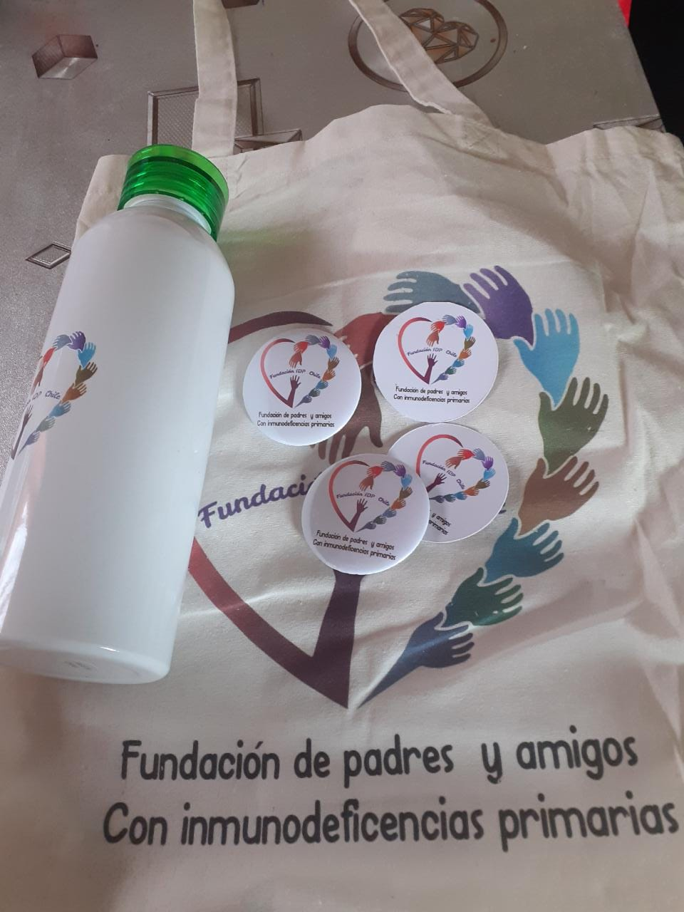
Chile
IDP Chile Foundation
Projects:
This year they held two events:
Social meeting with their members in a restaurant on April, 29 sharing pizzas and lots of conversation. They gathered 18 people and shared some gifts with logo of the Foundation.
Organised a remote zoom meeting, in which they brought together their members, especially from regions outside of Santiago, specialised medical personnel and representatives of IPOPI. The progress of the foundation, the website, formalisation of activities and contacts with new members were presented.

Slide 8
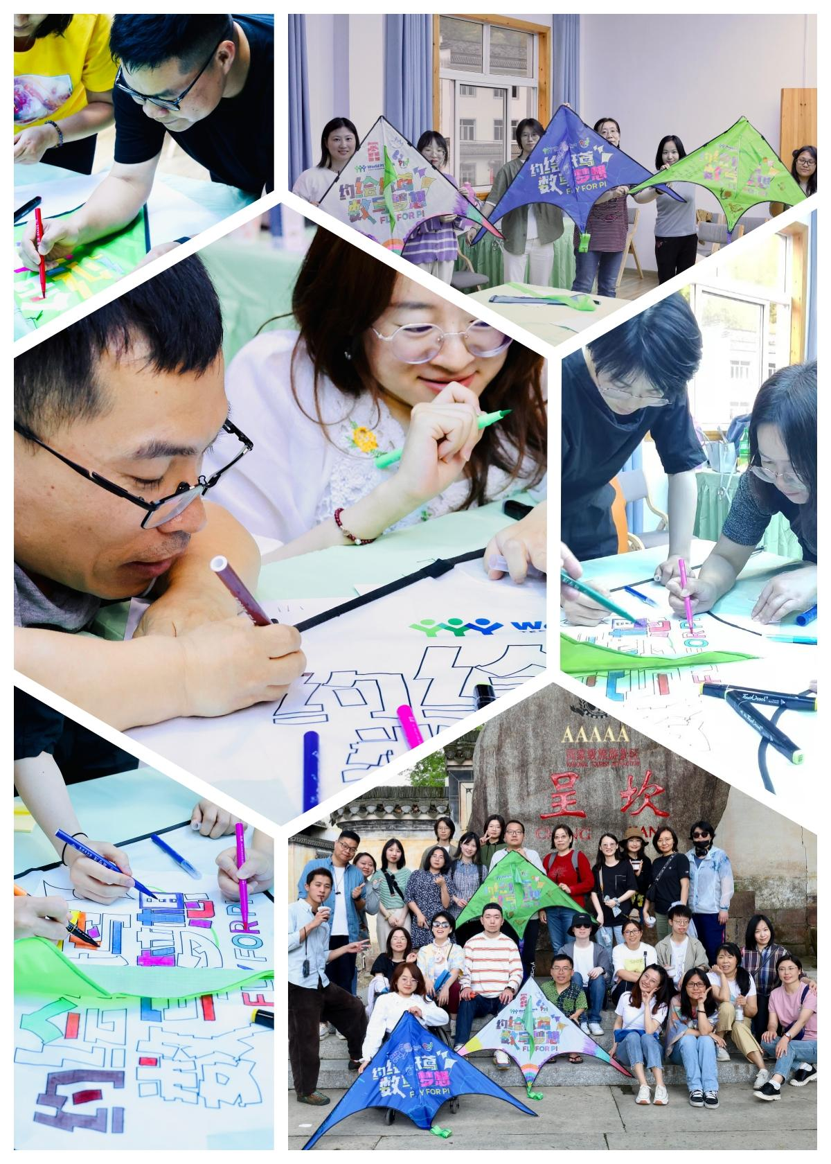
China
PID Care China
Project: Fly for PI - 【约“绘”纸鸢 “数”写梦想】 2023年国际原发性免疫缺陷宣 传周（World PI Week)
This year, their volunteers proposed using kites to encourage PID patients to join the awareness campaign.
The 150 kites featured QR codes for patient surveys, combining fun with data collection.
The kite-flying event united patients, families, doctors, nurses, and students across cities like Guangzhou, Beijing, Chongqing, and Shanghai. Their participation showed love, care, and support for PID patients in China.
Beyond the celebration, they emphasized the importance of accurate data collection and analysis to better understand PID patients´ situations and improve treatment strategies. They invited more individuals to join the cause and actively engage in data-related efforts.

Slide 9


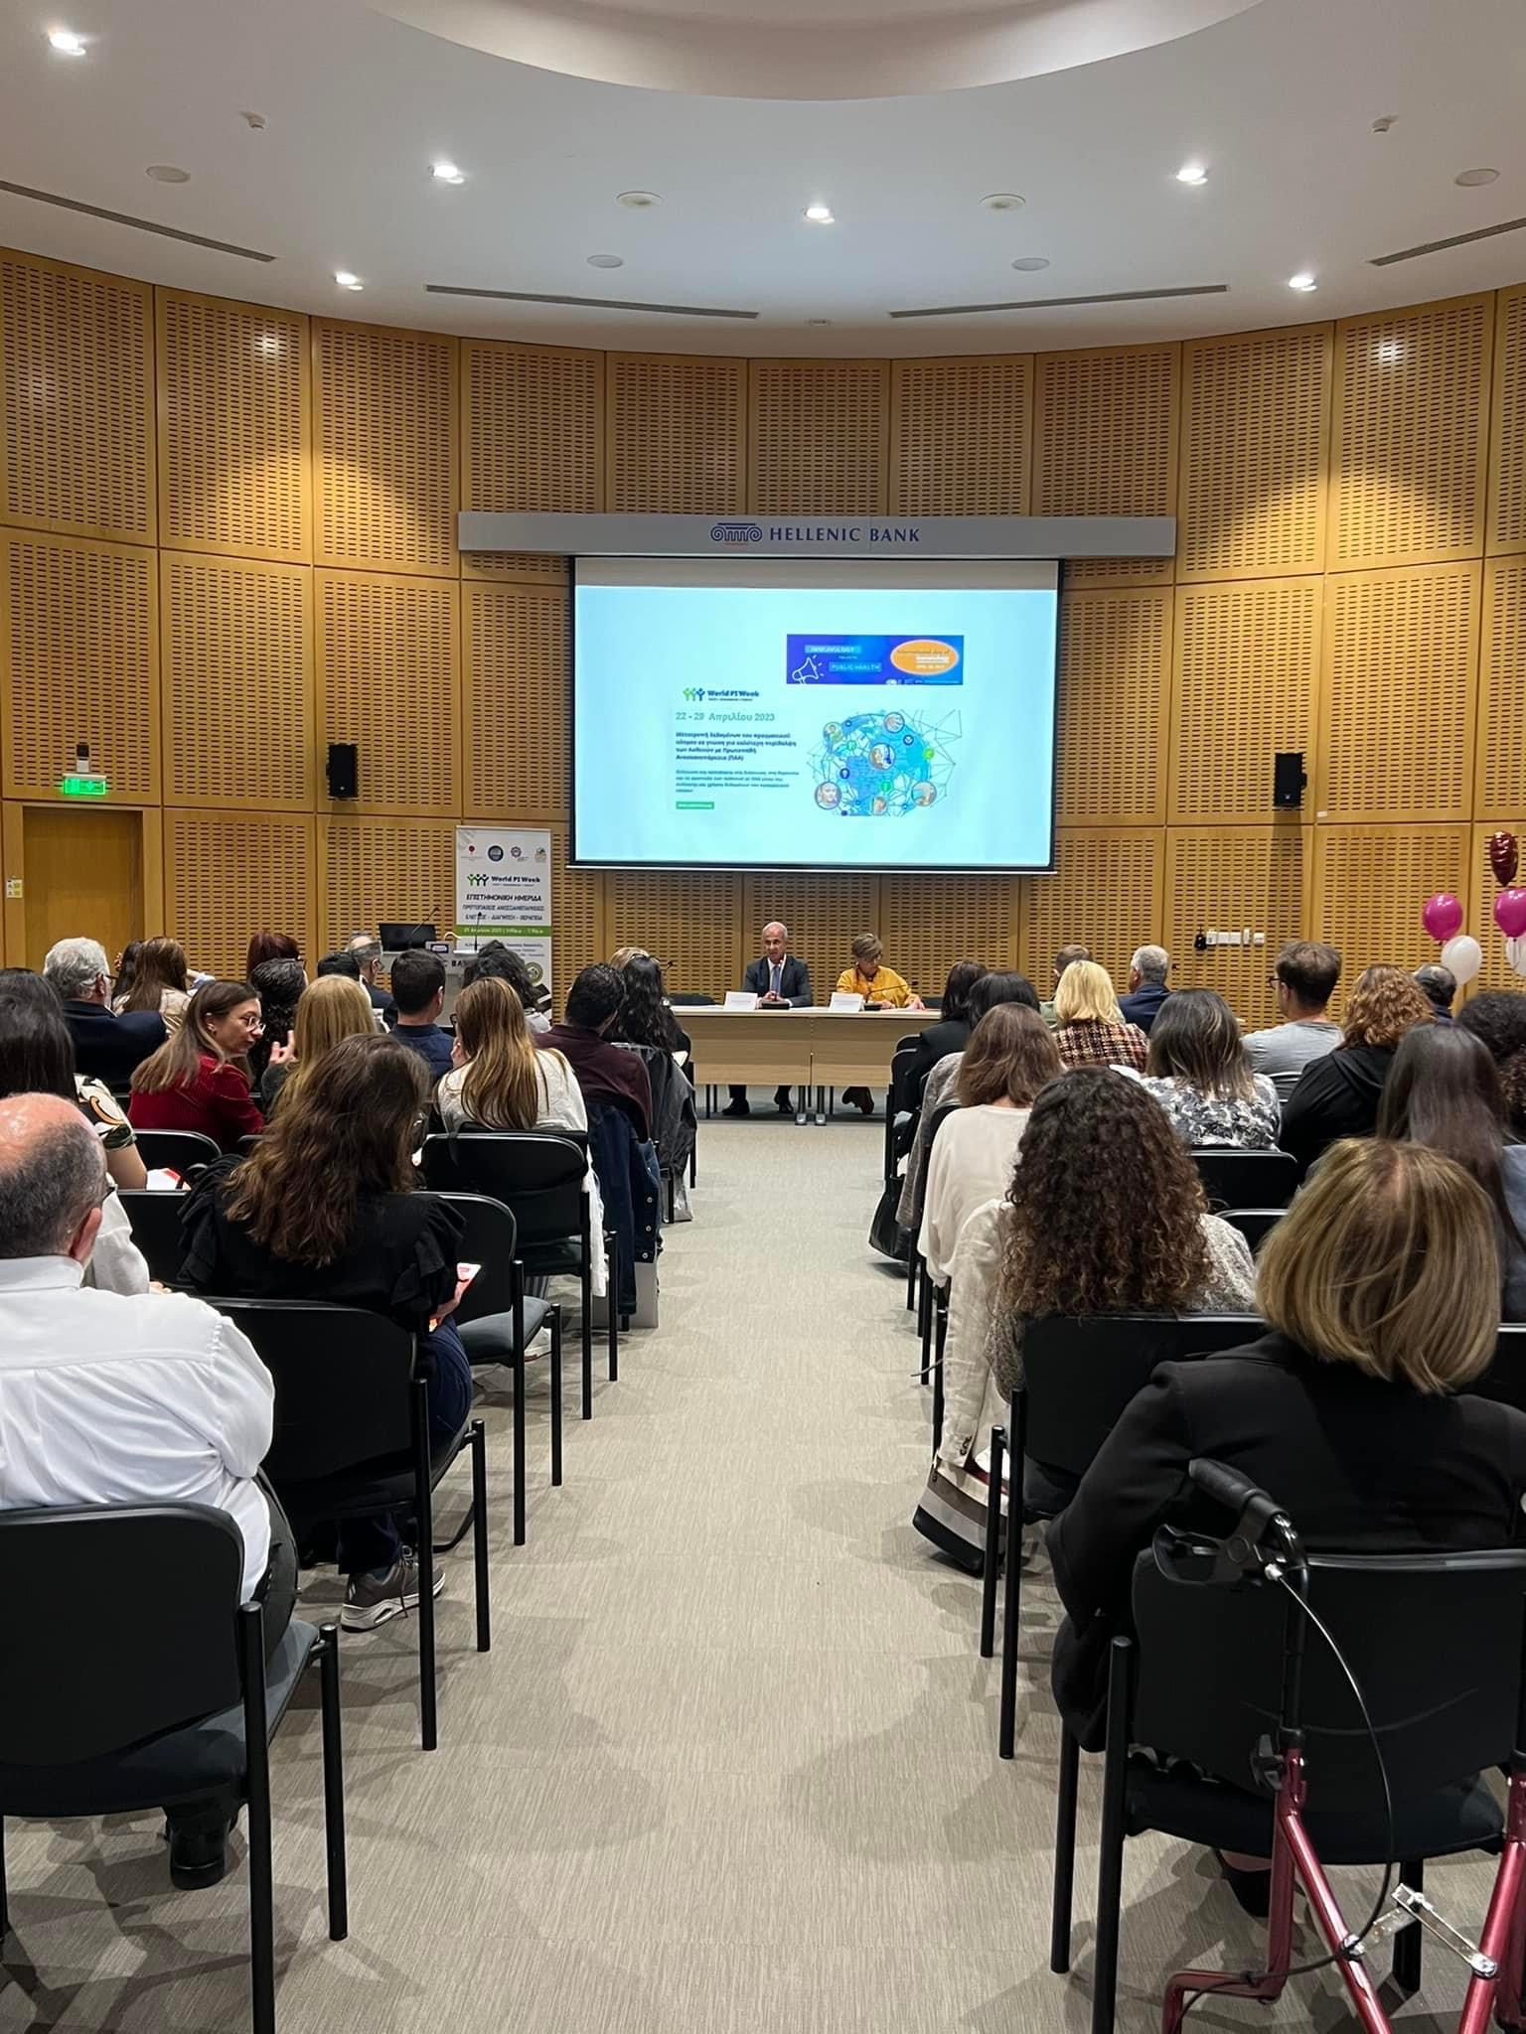
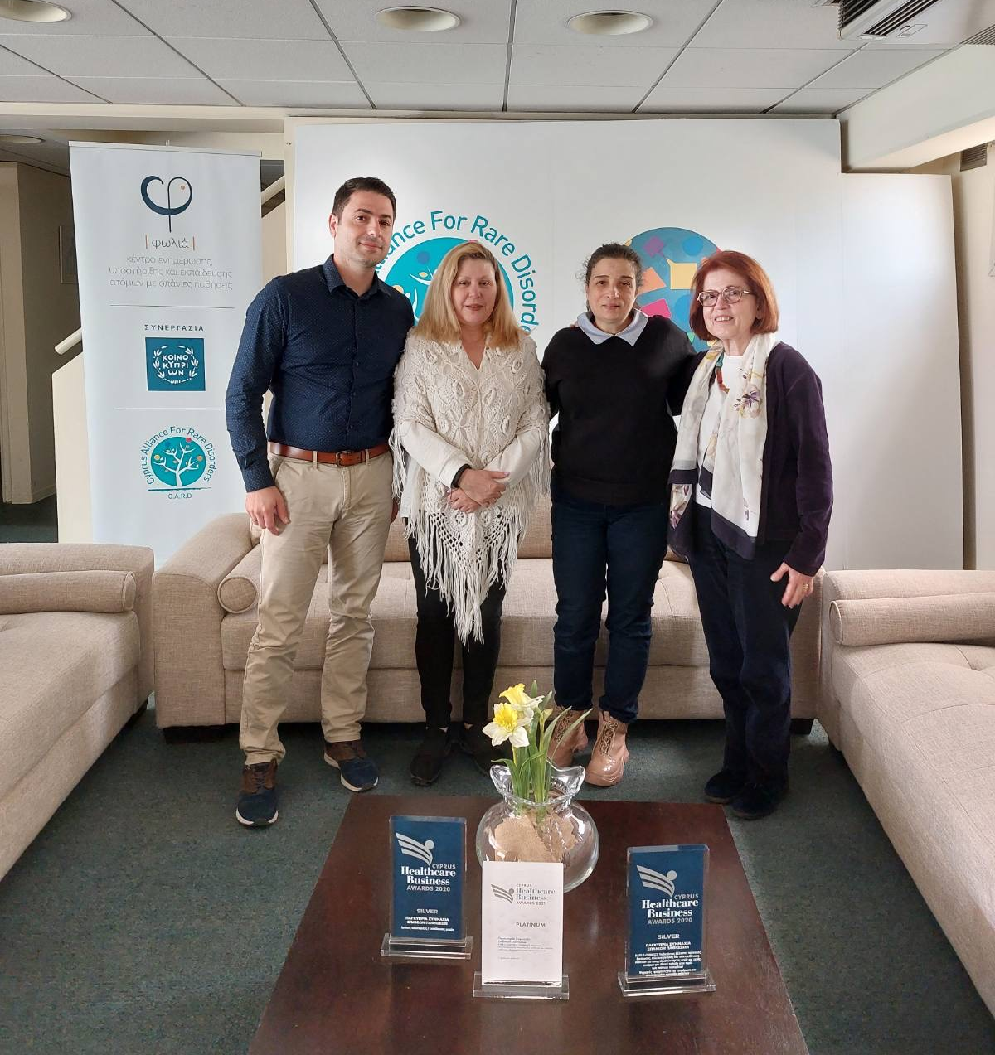
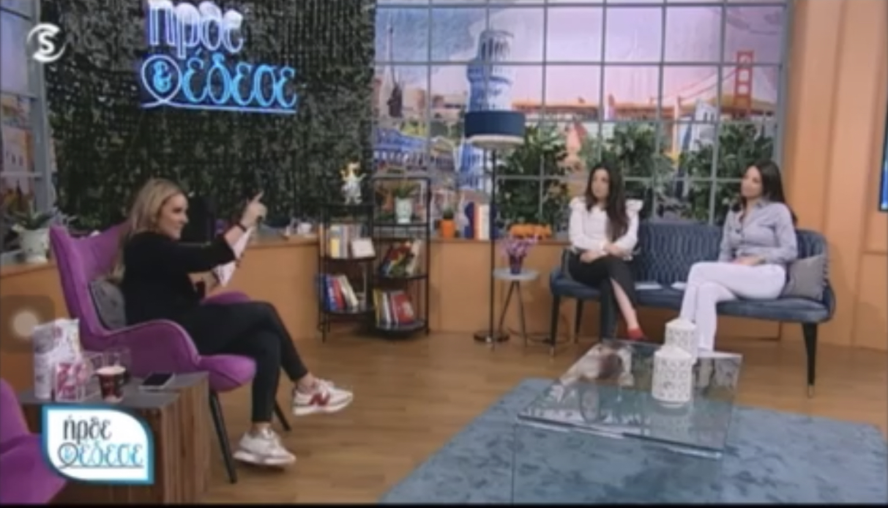
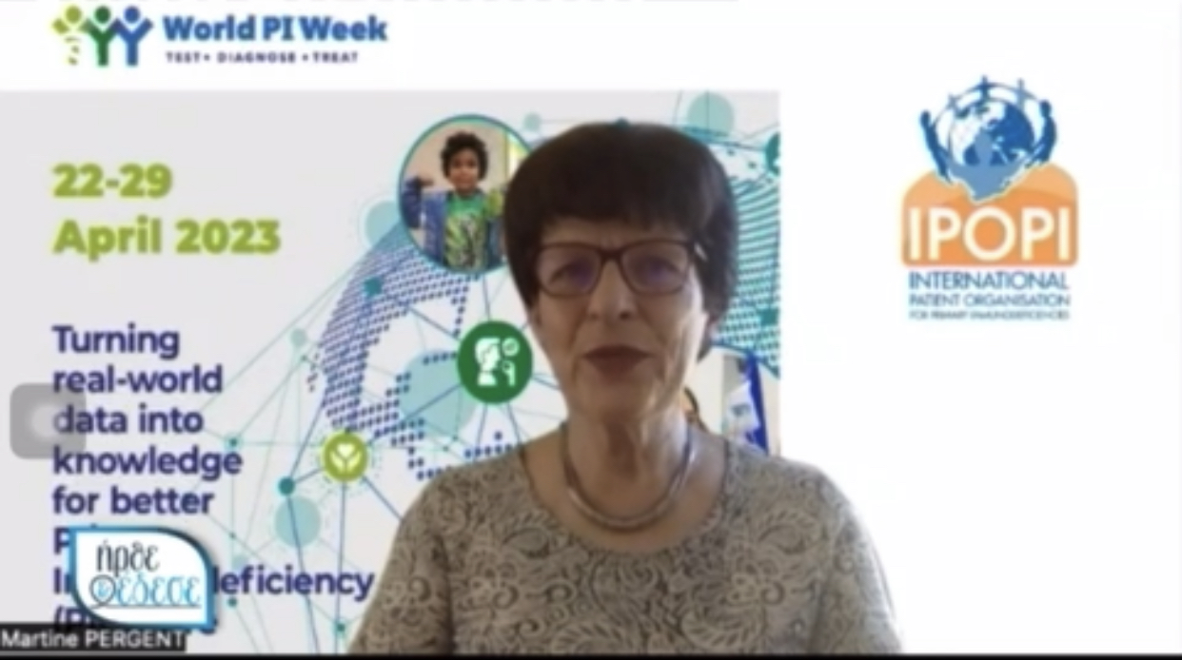
Cyprus
The Association of People with Primary Immunodeficiency
and Friends of Cyprus
  Projects:
    Scientific Conference - Primary Immunodeficiencies: Test – Diagnose – Treat (21.04.2023).
    Visit Dr. Marias Kanariou at Cyprus Alliance for Rare Disorders (C.A.R.D.)
    Invited to the morning show together with the Karaiskakio Foundation to inform and raise awareness about WPIW. Martine Pergent, IPOPI President provided greetings by video.
    Translated to Greek the IPOPI Statement “A PID causing a heavy burden of disease must always be recognised as a disability” in collaboration with Dr. Maria G. Kanariou, Pediatrician-Pediatric Immunologist Director, Pediatric Immunology in IASO PAIDON

Slide 10

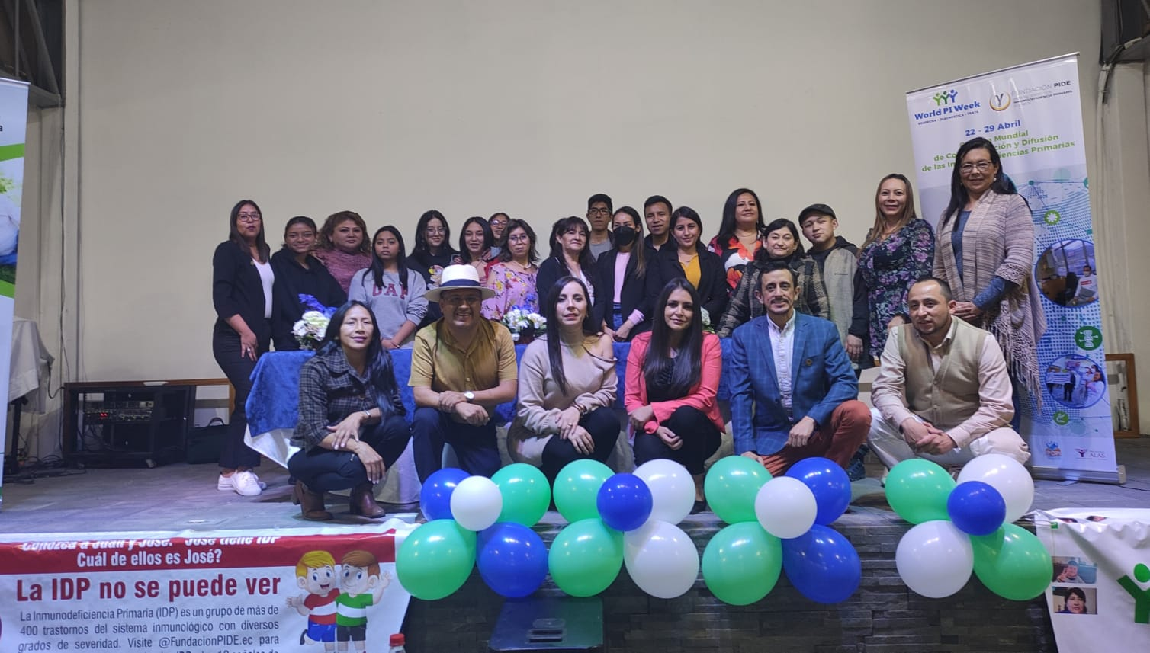
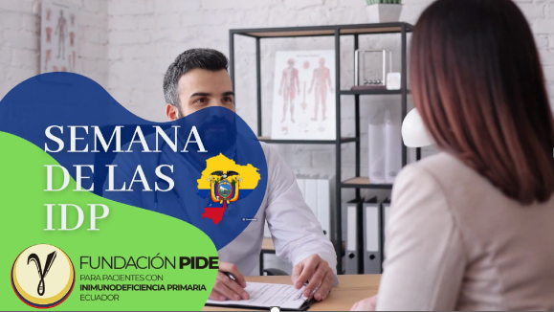
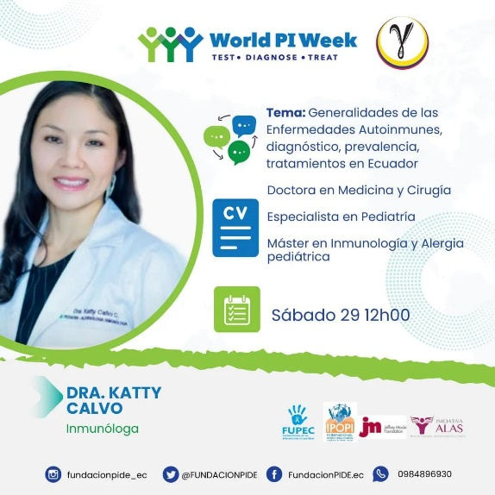
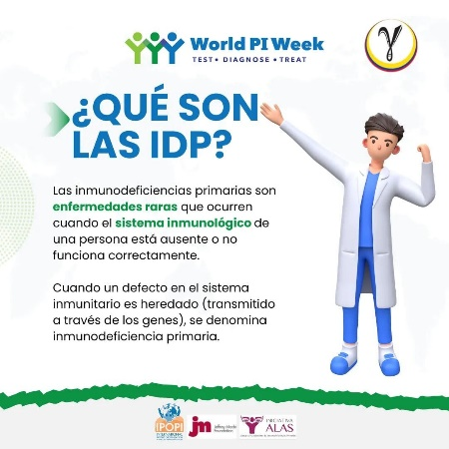
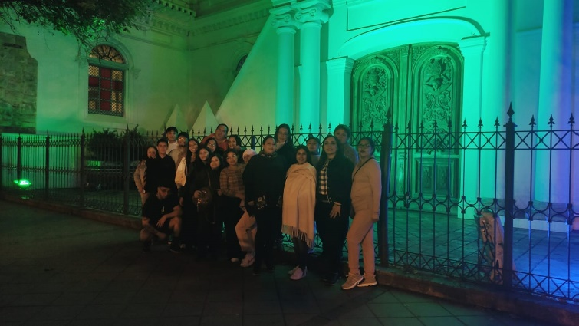
Ecuador
Fundacion PIDE, para pacientes con inmunodeficiencia primaria-Ecuador
  Projects:
  Developed videos and supporting material and shared them on social media during WPIW.
  Held 1st national symposium of PIDs, on April 29.
  Illuminated the emblematic monument - Old Cathedral in Cuenta.

Slide 11

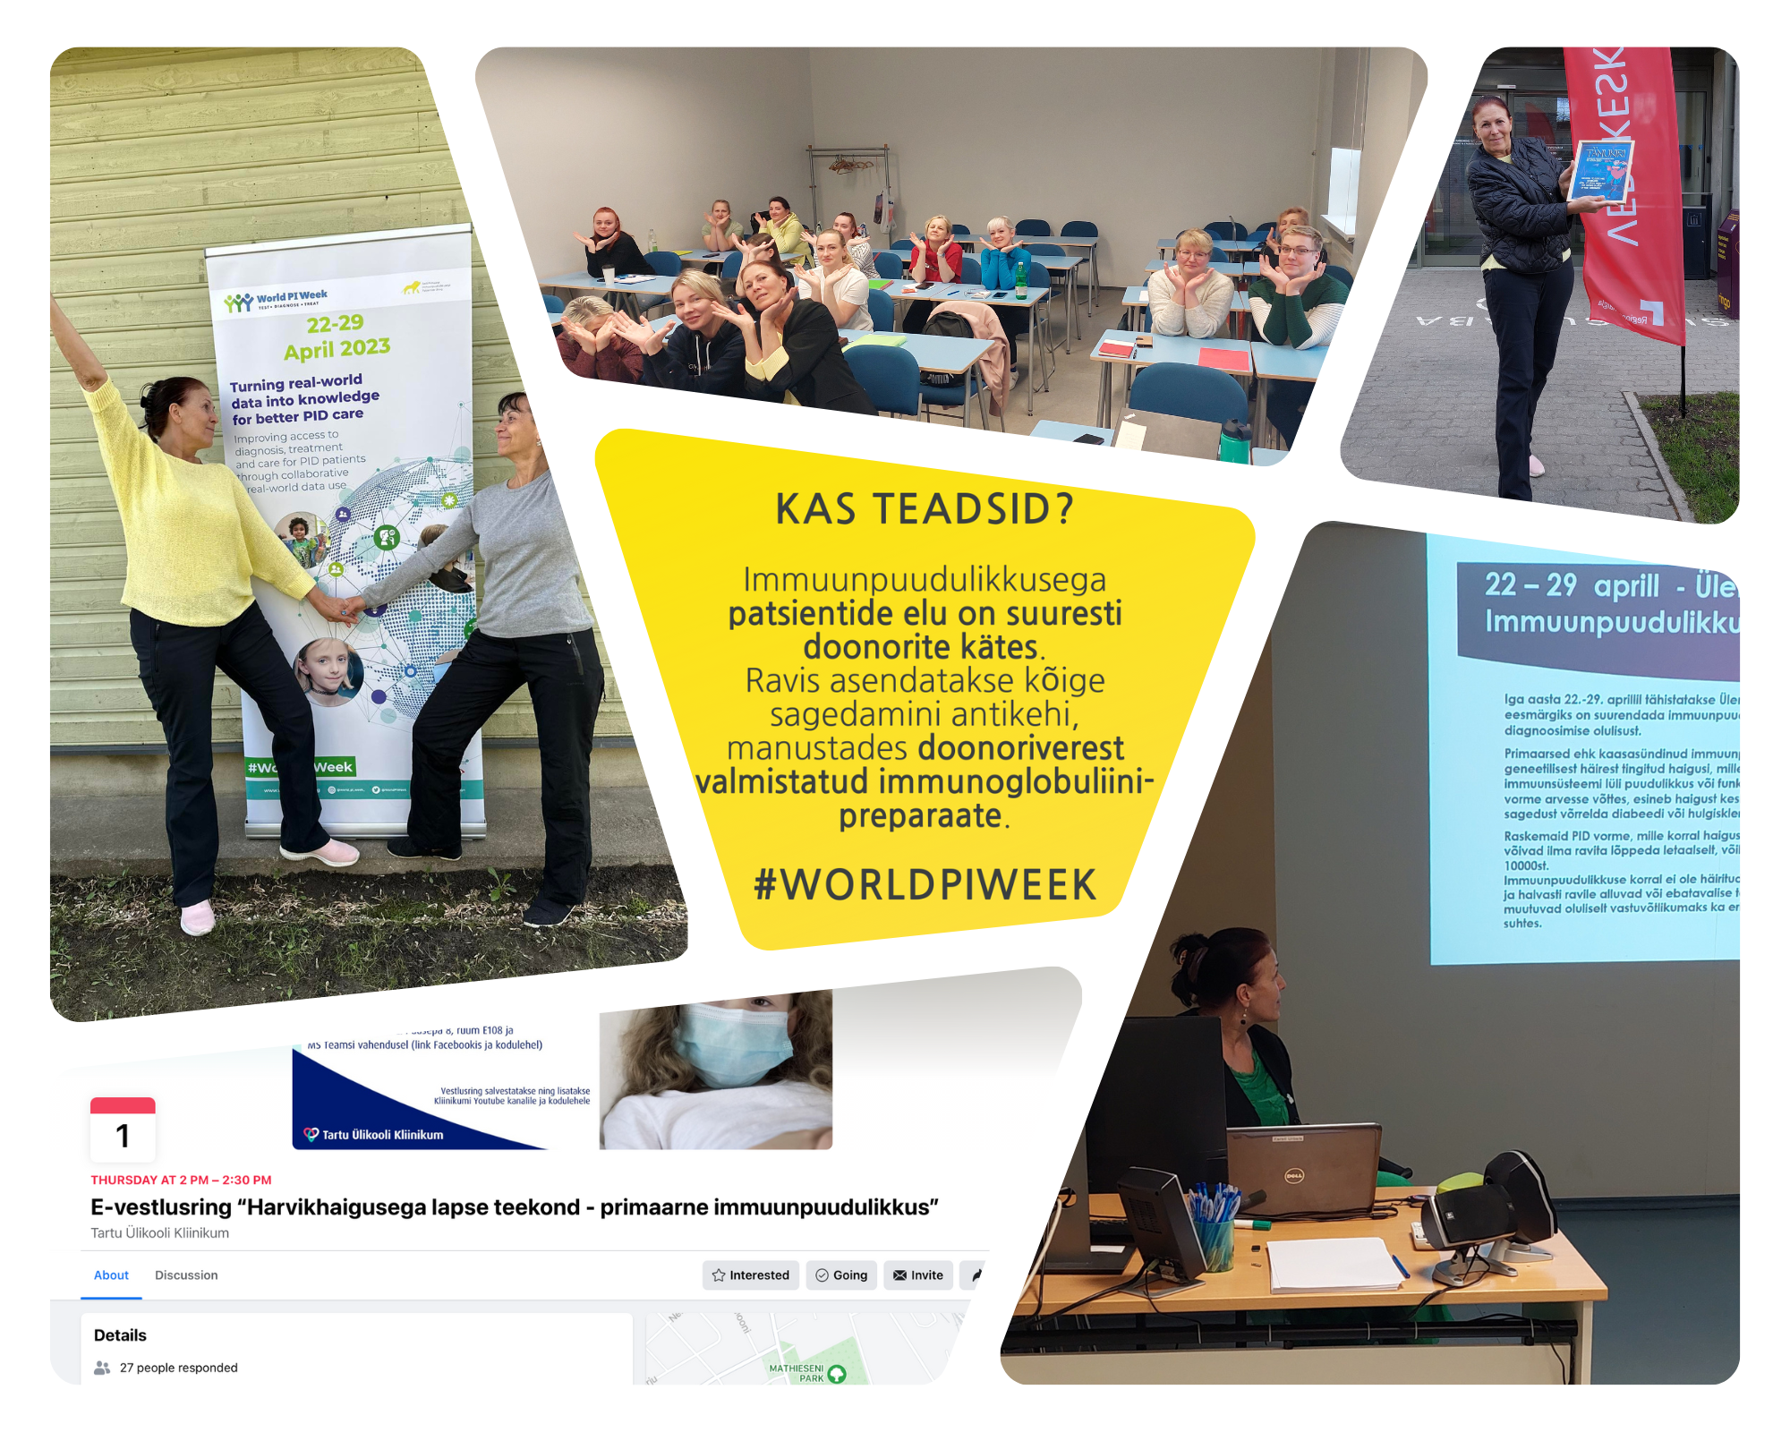
Estonia
Estonian Association of Patients with Primary Immunity (EAPPI)
Projects:
Seminar-presentation at Tallinn University of Health and at Medicum.
Discussion round about rare disease “Primary Immunity“ at Tartu University Clinic (June,1).
A dream day this summer for a 9-year-old child with PIDs in cooperation with the Estonian charity fund Minu Unistuste Päev.
Released new social media pages (Facebook+Instagram).
Social media campaign "Did you know?" about immunodeficiency.
Letters of thanks to blood centers "Thank you for being our hero!".
2 banners with informative content for medical students in two Estonian health colleges (Tallinn and Tartu).

Slide 12
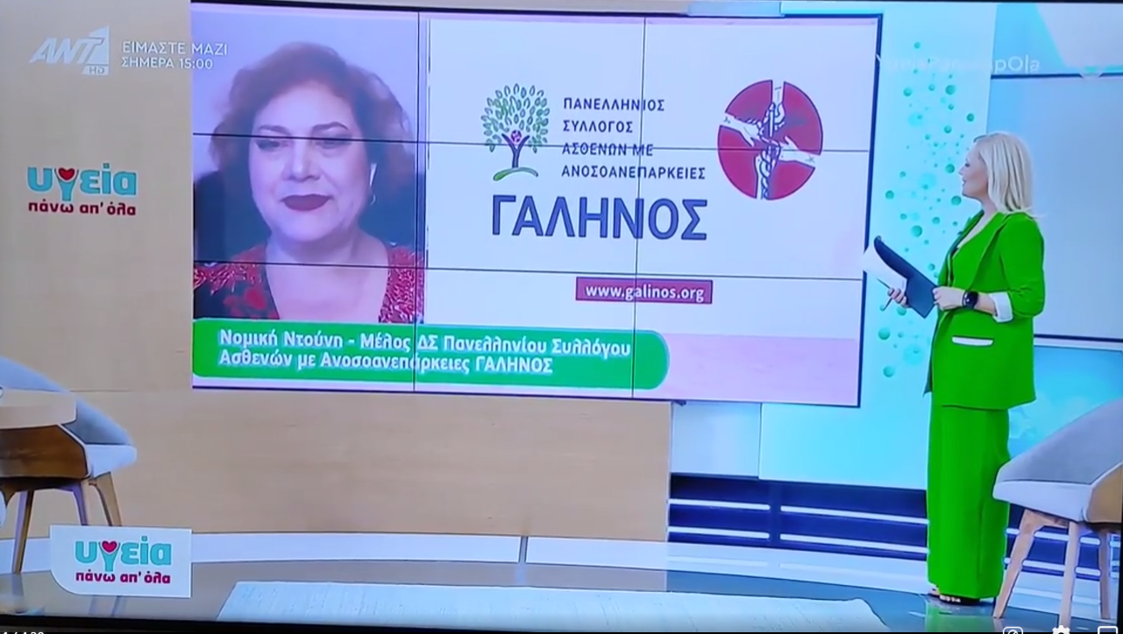
Greece
Immune Deficiency Association of Greece (Galinos)
Project: Media awareness campaign
Creation of a 35-second informational advertisement video (advertorial) on PIDs. This was broadcast on national Greek TV, radio and the internet from April 17th - May 17th, 2023.
The advert also appeared during an interview on a popular talk show about health, during WPIW.
The people who took part in the video were actual patients – Board members, who shared valuable information and personal experiences, which touched many.
Received an overwhelming response: website, YouTube channel, Facebook page, phone calls and messages from people who wanted more information on PIDs and also from people who had been diagnosed, but did not know about Galinos, many of whom subsequently became members of their organisation. They also received many accolades from the medical community for this important message and their efforts to educate the general public as well as raise awareness for PIDs.

Slide 13
Iceland
Lind Iceland
Projects:
On April 25, 2023, held a meeting with nurses at the Children's Hospital and the Department of Immunology.
Presentation of the immunology department's new website, which they have been working on for the last year.
Prepared educational material and a meeting for schools of nurses.
2 meetings will be held in November: one with school nurses and staff
  Educational meeting for school nurses, medical students and other health workers.
  Meeting for parents of children with PID and adult patients.

Slide 14
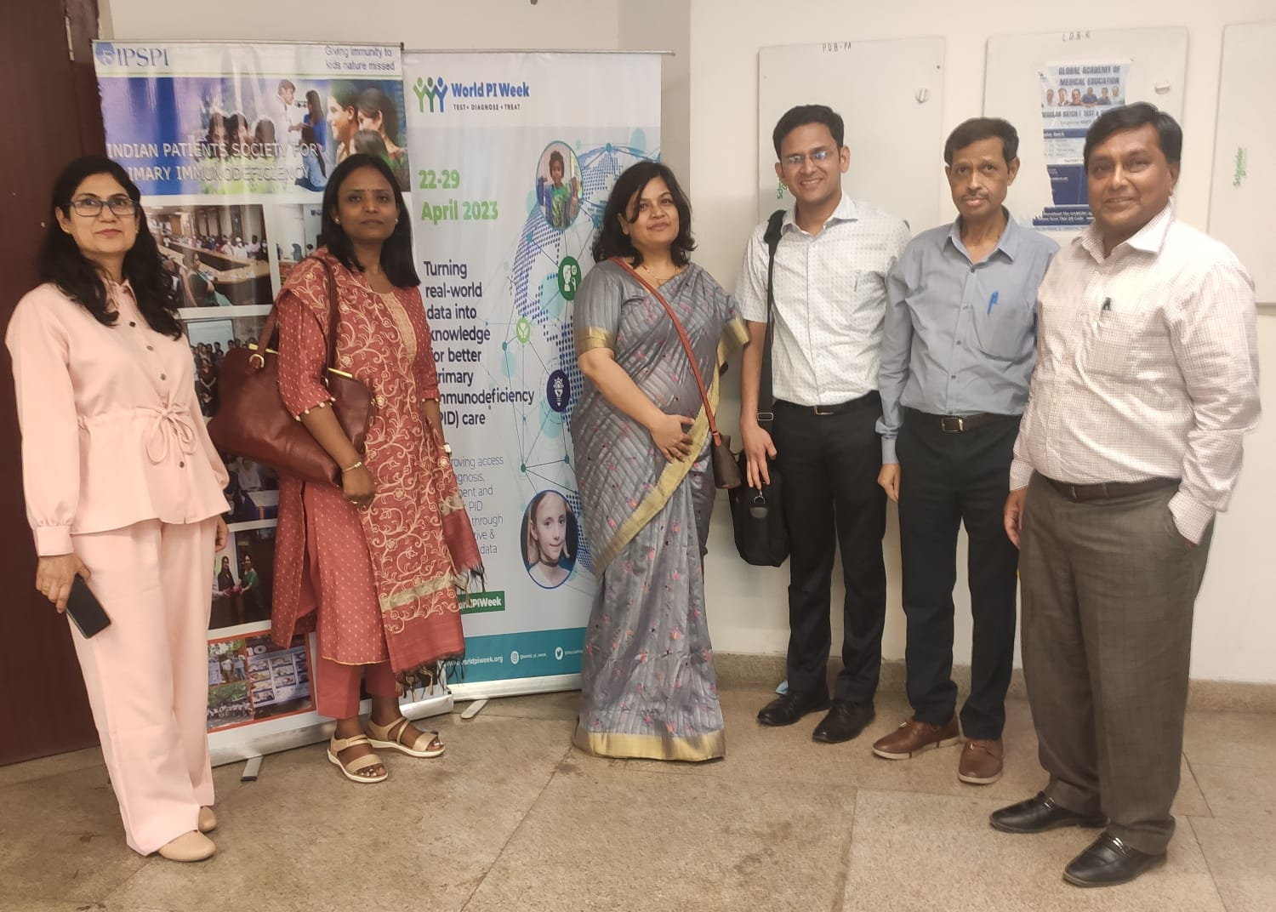
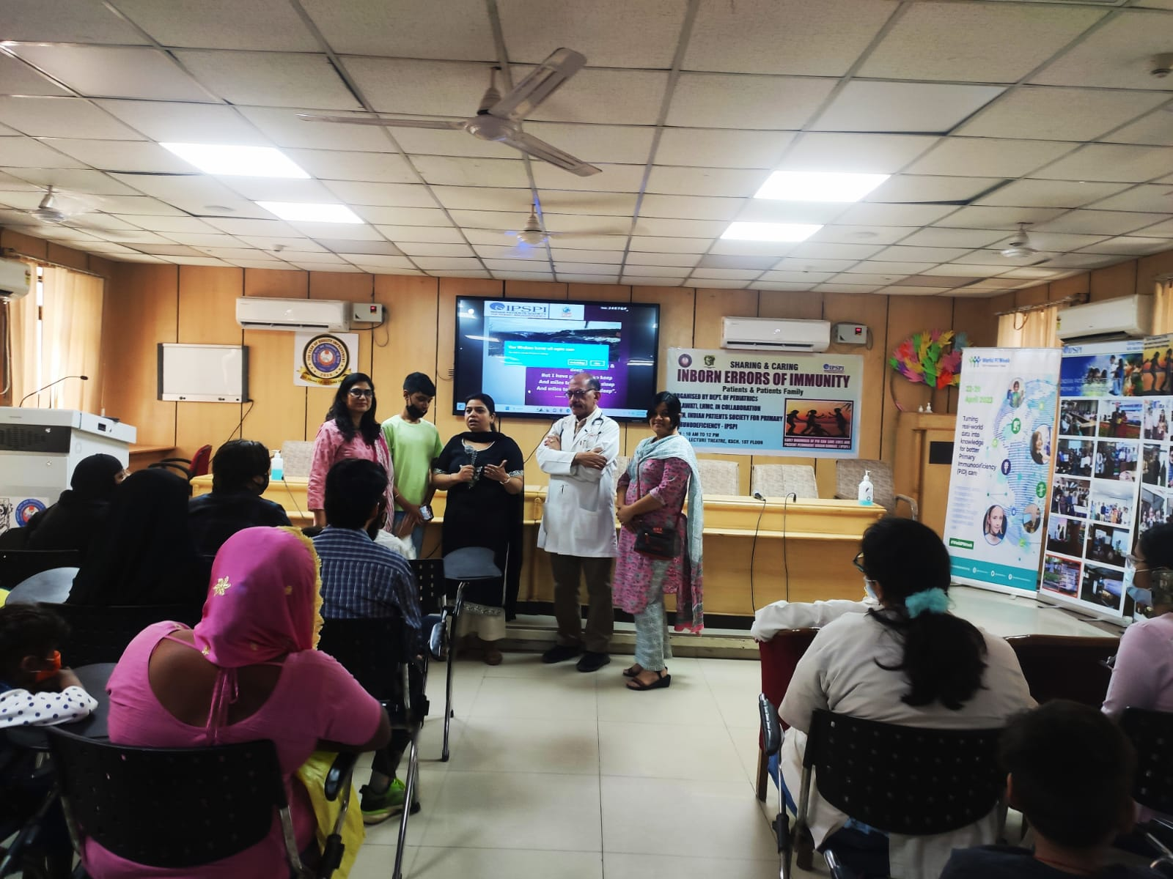
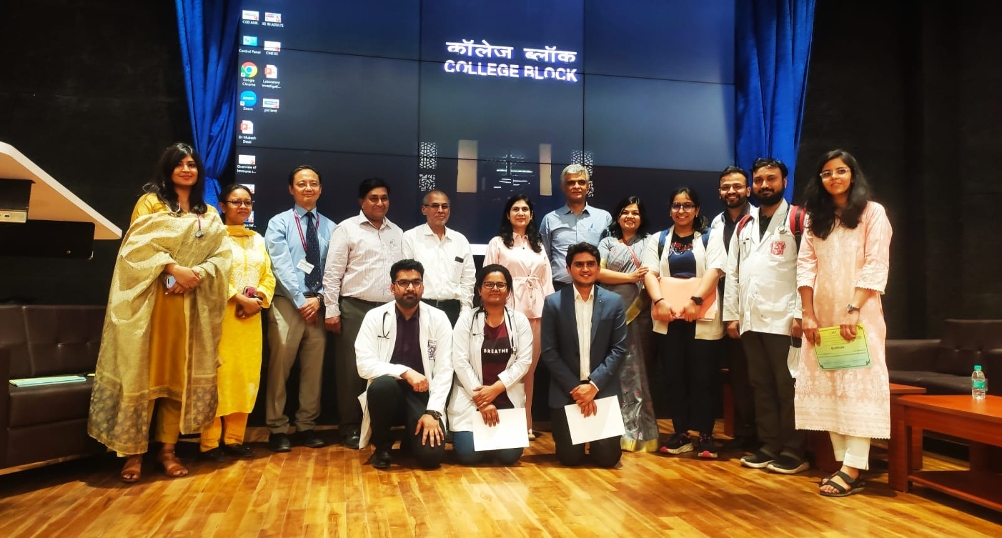
India
Indian Patients Society for Primary Immunodeficiencies (IPSPI)
Projects:
Organsied a Sharing and Caring of IEI Patients and Family Event on April, 27 in LT, KSCH in collaboration with KSCH, LHMC, New Delhi.
Organised CME on IEI on April, 29, in Auditorium, Academic Block, LHMC, New Delhi in collaboration with Medicine and Pediatrics Department of LHMC, New Delhi.

Slide 15
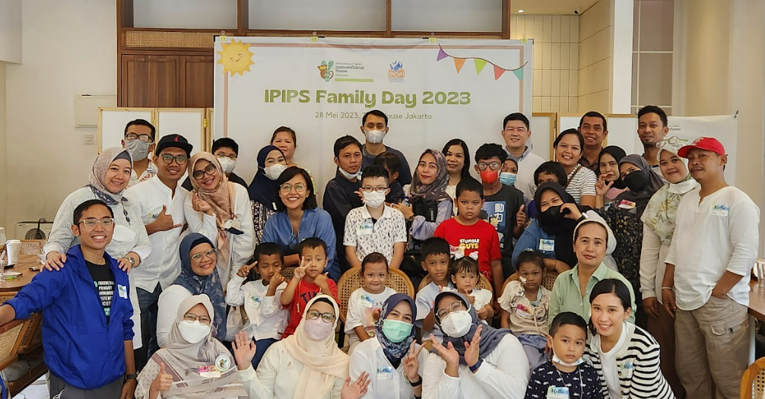
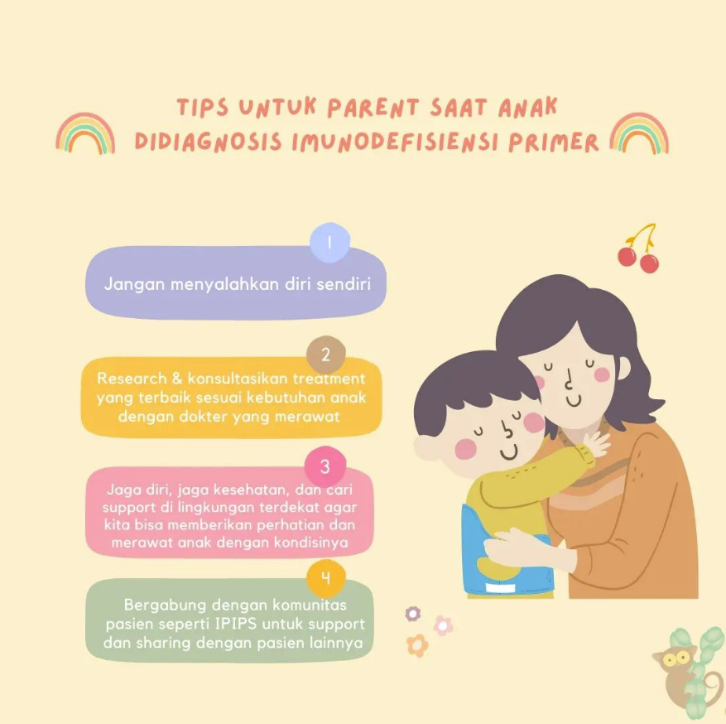

Indonesia
Indonesia Primary Immunodeficiency Patients Society (IPIPS)
Projects:
1) Indonesia Registry Work Plan Launch – The goal is to create and launch a Pilot for Indonesia PI registry. Timeline: 12 Months Project. Currently the team is on process requirement gathering and tools selection.
2) Held a Family Day on May, 28, delayed from April 2023 due to Eid Mubarak Long Holiday (21-28 April 2023). Attended by 50 participants from Patients and Family as well as on-Training Pediatrician and Pediatrician Immunologist.
3) Social Media and Online Article - The campaign focus on the importance of data as part of PID advocacy in Indonesia, as well as tips for family and parents in handling PID. The data for PID advocacy post also acts as a segway for their initiative to start working on registry.

Slide 16
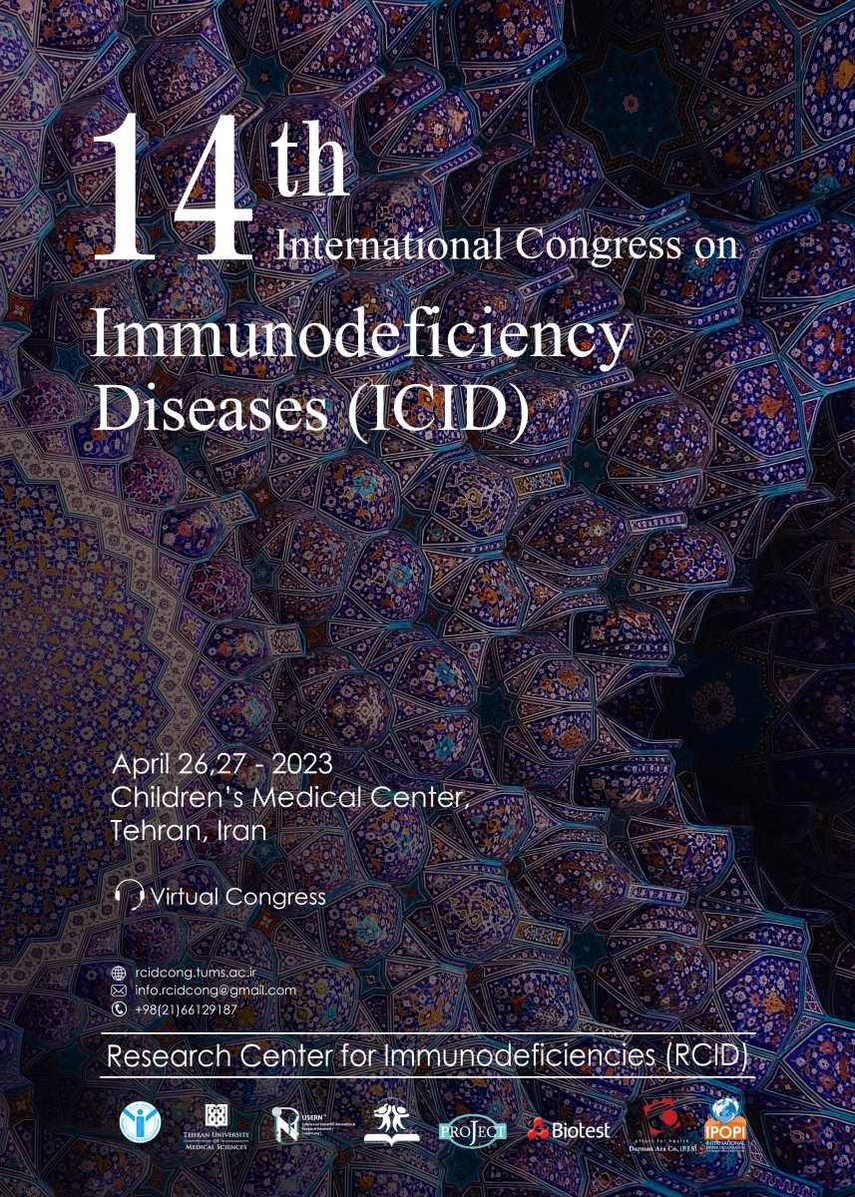
Iran
Iranian Primary Immunodeficiency Association (IPIA)
Project: The 14th International Congress of Immunodeficiency Diseases (ICID) during April 26-27
The congress was done virtually: https://rcidcong.tums.ac.ir/ for pediatric immunologists, pediatricians, nurses, students, patients and their families.
There were 28 lectures, not only from Iran, but also from other countries, including US, UK, Germany, France, Italy, Sweden, the Netherlands, Turkey, Kuwait, and Armenia.
They also encouraged the patients to express their feelings by drawing paintings for the International Festival of Paintings for Pediatric Patients.
There was also an exhibition area at the Immunology Congress, that allowed to increase the knowledge of healthcare workers about PIDs, and highlight the importance of mental health via the Health and Art (HEART) group.

Slide 17
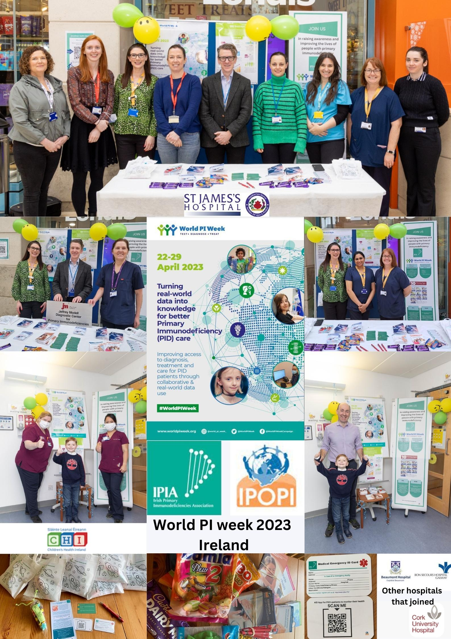
Ireland
Irish Primary Immunodeficiency Association (IPIA)
Projects:
Joined forces with various hospitals to celebrate WPIW. Created and purchased posters, information leaflets, goody bags, treats, emergency cards, and much more to give to PI patients and distribute among the public who visited the stands in the hospitals during that week.
The event was a huge success and received positive feedback from both patients and hospital staff.
Feedback: “Always good to generate some positive news”; “The leaflets in the goody bags were a welcomed addition and acknowledged by parents. Great to see all the hard work paying off with the advancements in screening for PI’s”.

Slide 18
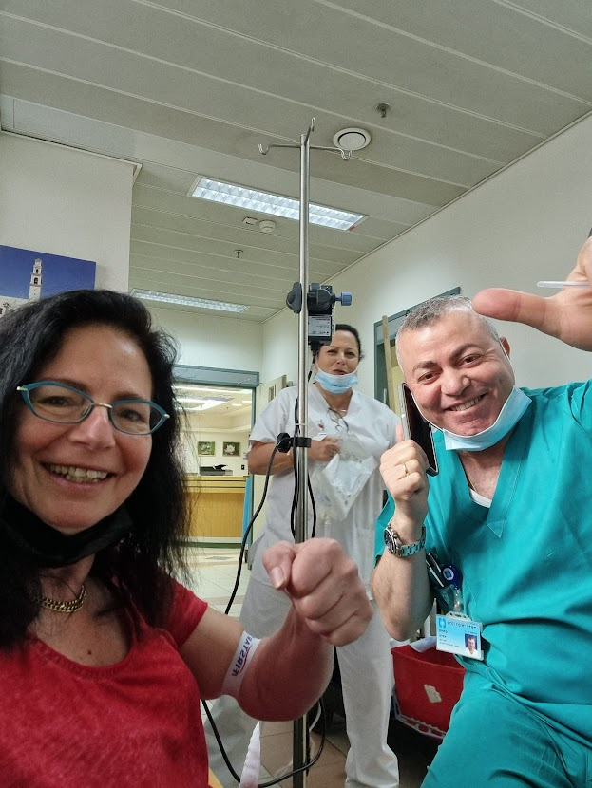

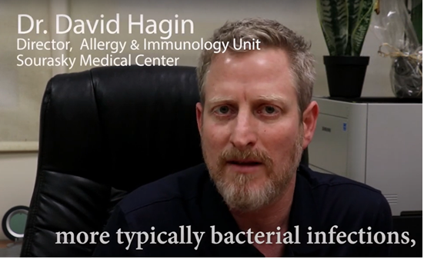

Israel
Bubble Care
Projects:
Sharing on media channels (website and Facebook): 10 warning signs, 2 doctors’ podcasts, a doctor’s article, life stories of patients, videos).
A presentation to Immunologist doctors in the country.
Cooperated with Takeda pharma to make 2 videos. Ruti Steinberg interviewed Dr. Nufar Marcus: What are immune deficiency diseases, how to diagnose and treat adults and children.
Created 4 new stories of PID patients (3 translated into English).
Published articles in media: A story of a family with a small kid with XLA was published in Mako, electronic part of a major TV channel (12) (with a children’s hospital, Shneider).
Shared on media channels the 3 videos made previously (with English subtitles).

Slide 19
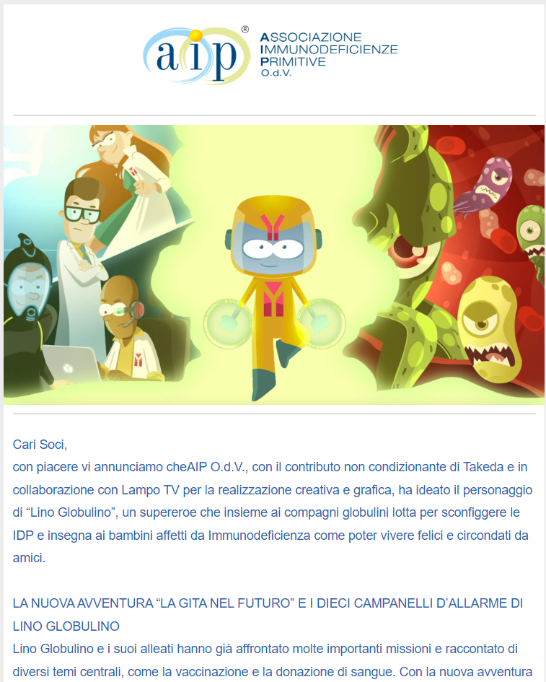
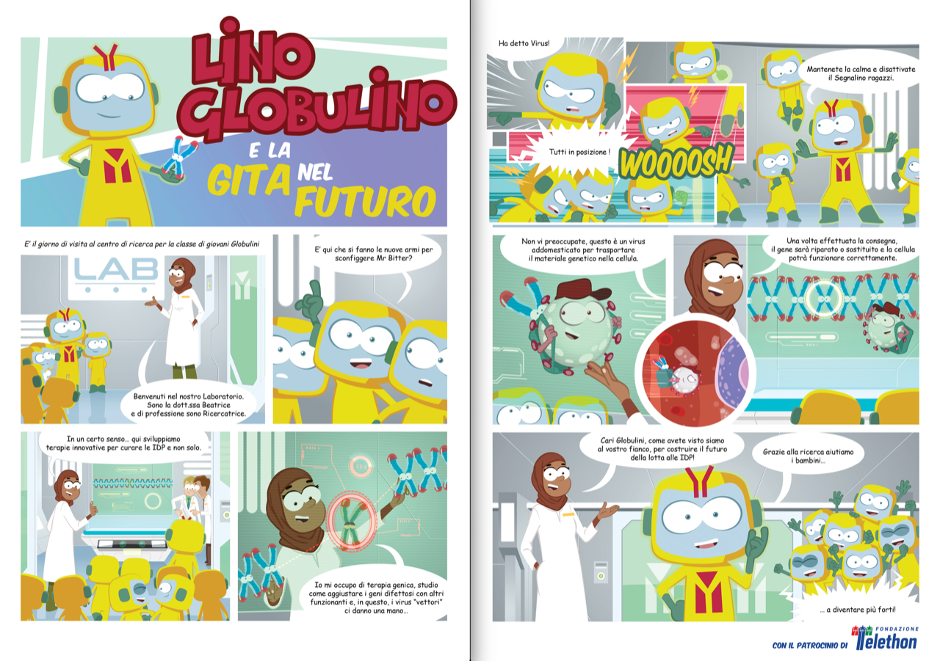
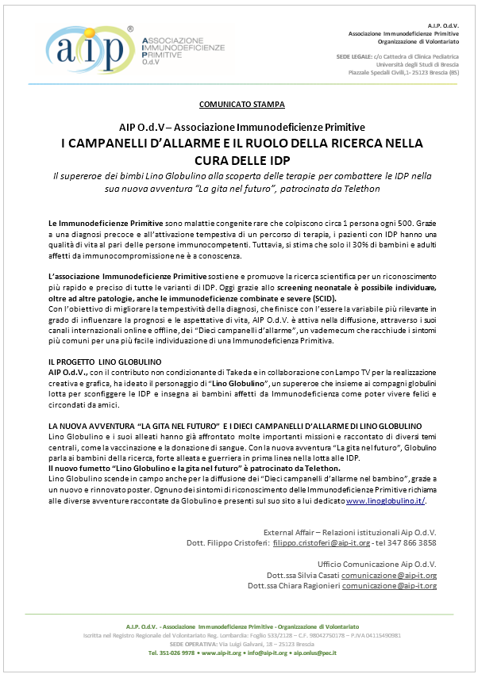

Italy
Associazione Immunodeficienze Primitive (AIP O.d.V.)
Project: The Adventures of Lino Globulino
Launched a brand new comic episode of Lino Globulino, the superhero of children with Primary Immunodeficiencies “Lino Globulino e la gita nel futuro”. In this latest story, Globulino and his friends discover the importance of scientific research on advanced therapies to fight again PIDs.
Shared the new episode in multiple ways:
  Website
  Youtube: resulting in 204 visualizations
  Sent a newsletter to their associates and contacts: 4341 contacts.
  Posted on Facebook: resulting in 640 impressions, 19 interactions and 35 clicks on their website.
  Spread a press release.

Slide 20
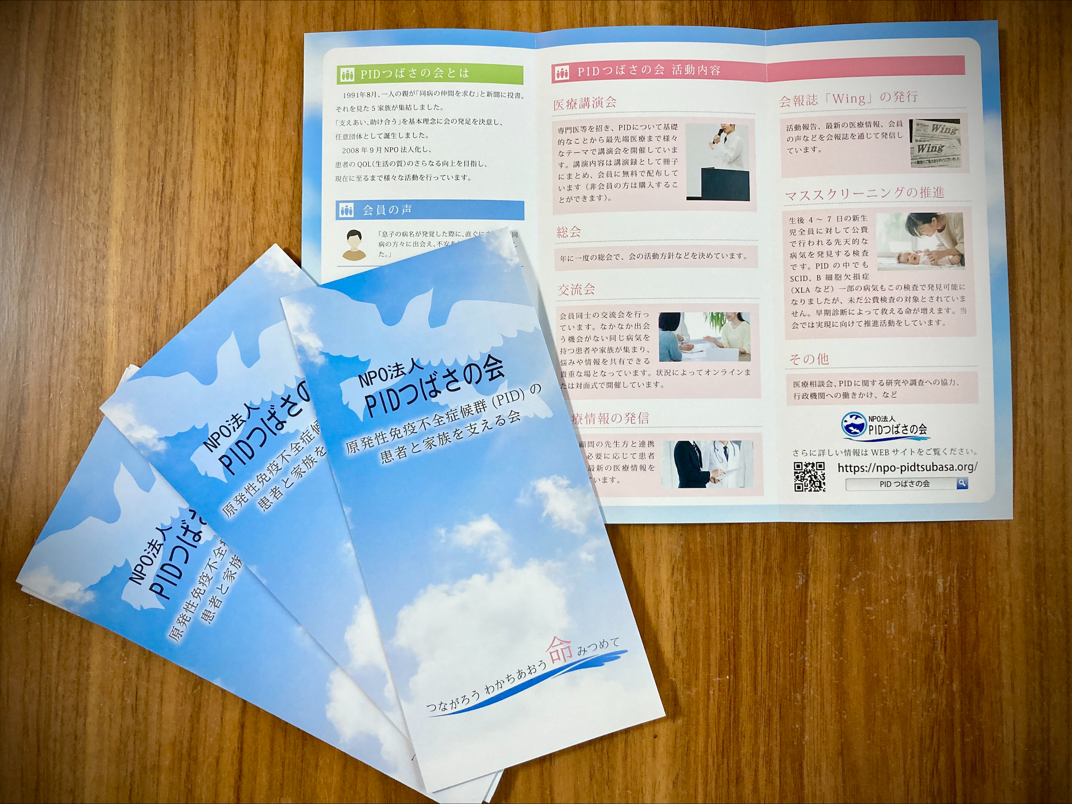
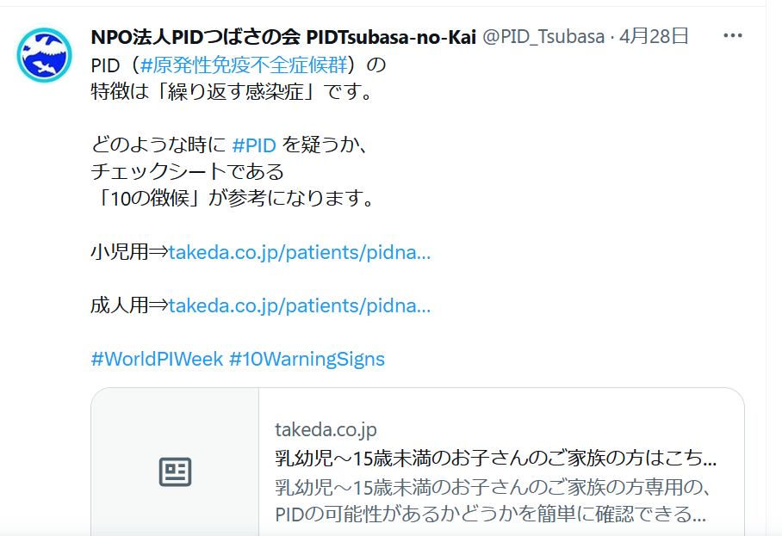
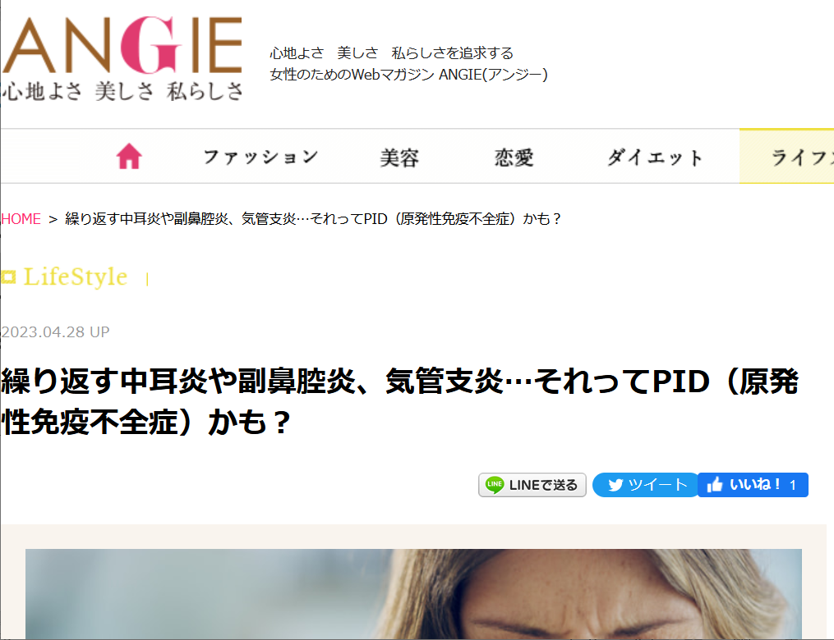
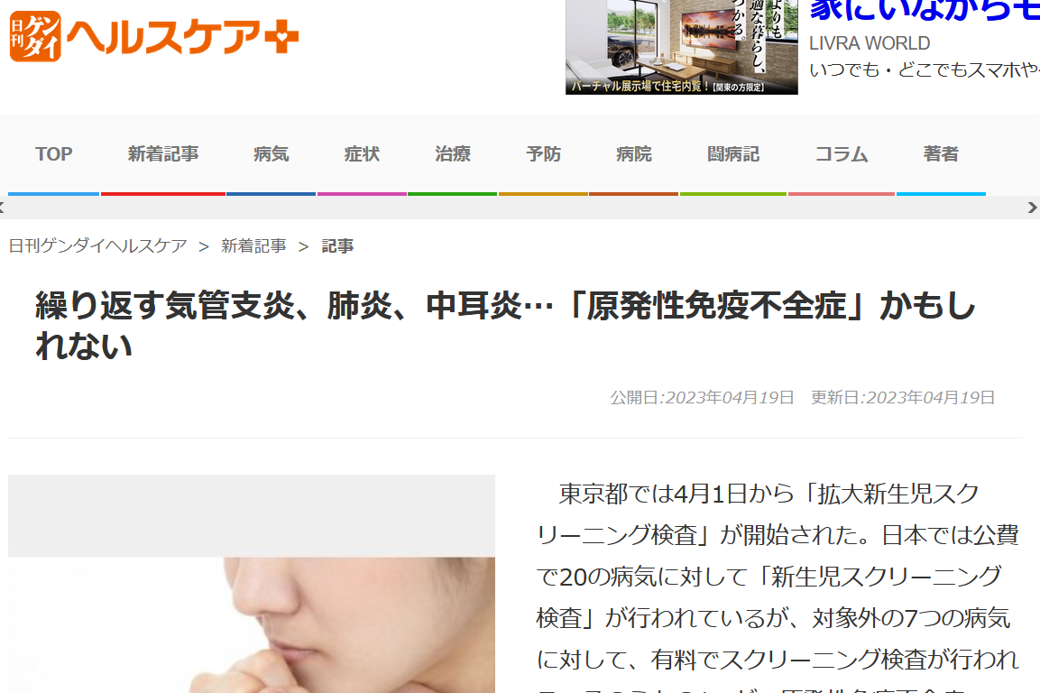
Japan
PID Tsubasa-no-Kai
Projects:
Held a media conference (co-hosted by Takeda) in Tokyo on 6th April and 6 media outlets published feature articles on PID.
Posted the “10 Warning Signs” information on Twitter.
Distributed their leaflet at the media conference.

Slide 21
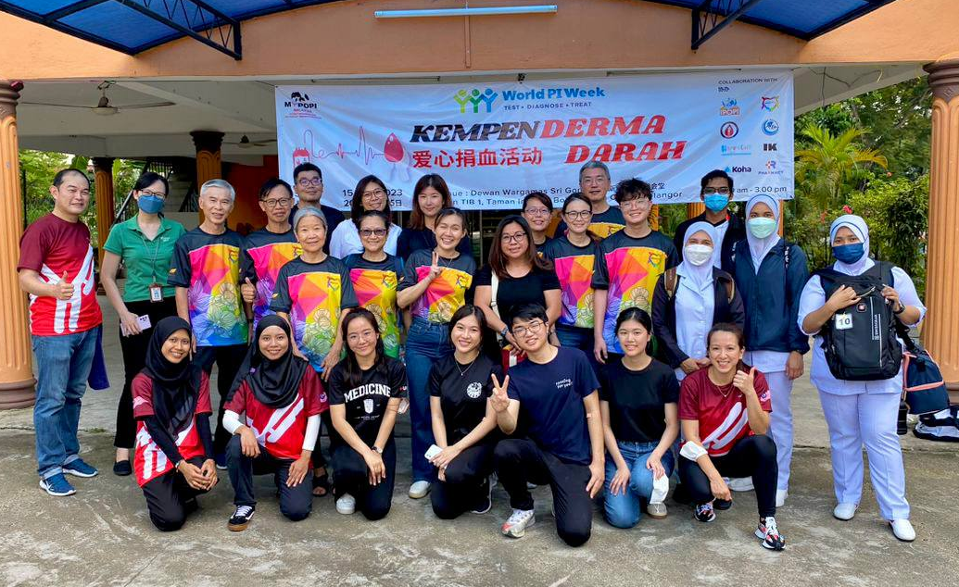
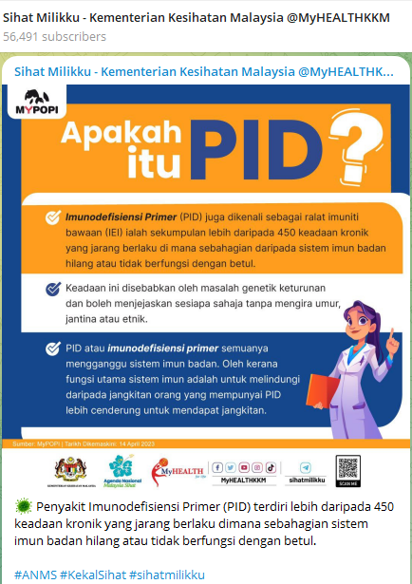
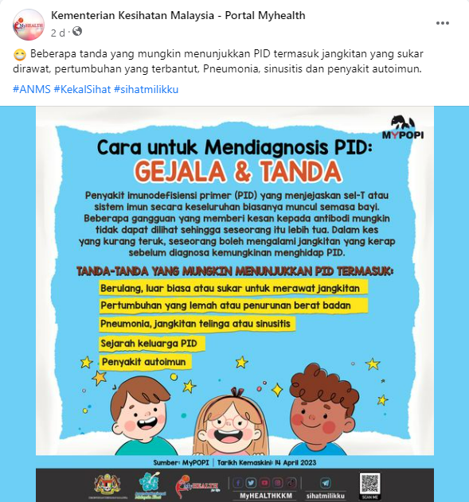


Malaysia
Persatuan Pesakit Imunodefisiensi Primer Malaysia (MYPOPI)
Project: Organised a Blood Donation Campaign & Collaborate with the Ministry of Health of Malaysia to promote awareness of PID on MoH Online Portals.
MYPOPI infographic posted by MoH on MyHealth Telegram Channel got 56,491 subscribers.

Slide 22




Mexico
Asociacion Mexicana para Pacientes con Inmunodeficiencias Primarias
Projects:
Visit to the Papalote Children's Museum
First Congress led by specialists with relevant topics on IDPs

Slide 23




Morocco
HAJAR
Projects:
Launch of a new service dedicated to PID patients
A party for children with PIDs:
  A quiz for children on PIDs (quiz test your knowledge IPOPI tools).
  Meeting opportunity between nurses, doctors patients and parents.
  Distribution of gifts for children.
  Watch the winning video of the awareness video contest by medical students.
Award distribution for best medical student awareness video.
A blood donation
A scientific conference about vaccination

Slide 24



Netherlands
Stichting voor Afweerstoornissen (SAS)
Projects: Social media polls and traditional SAS-Family day
Launched bi-daily polls on FB and Instagram pages linked to the WPIW theme (3-weeks ahead of WPIW).
On April, 22 hosted their traditional SAS-Familiy Day. With 130 visitors, medical speakers, nurses, personal experiences, ACT and an info market. The opening was spectacular with 3 exciting launches:
  Their WPIW video’s showing the process of blood/plasma from donor to immunoglobulin bottle.
  An expertise network made and maintained by SAS and all 7 PID-specialist hospitals in the Netherlands.
  Announcement of a national PID Empowerment event on September, 23 for all PID patients and their families residing in the Netherlands. With the cooperation of all 7 PID specialist hospitals, they hope to get 300 visitors and increase their number of SAS members.

Slide 25













Philippines
Philippine Patient Organization for Primary Immunodeficiencies (PhilPOPI)
Projects: Used comic strips on brochures, posters, leaflets, other promo items to promote PID/IEI awareness and raise funds

Slide 26

Poland
Association for Patients with Primary Immunodeficiencies (IMMUNOPROTECT)
Projects: Educational wobblers with 10 warning signs of PID for GPs

Slide 27





Portugal
Associação Portuguesa de Doentes com Imunodeficiências Primárias (APDIP)
Project: Family Day in Aveiro
A day meeting that included: Yoga session, talk about news in the PID field, and shared experiences between members.

Slide 28





Puerto Rico
Puerto Rico Alliance of PID Patients (APIP)
Projects:
Familiy activities - Most of our patients, families and doctors were present. Their event was very emotional since they had not been able to meet since the COVID-19 pandemic began.
Launched an education and awareness campaign using the social media networks, which provided very impressive positive results.
  Google: reach people (96k), impressions (200k), clicks (400); Youtube: views (7k), Impressions (100k), clicks (300); Facebook: reach people (7.1k), impressions (17.3k).

Slide 29






Romania
Romanian Association for Patients with Primary Immunodeficiencies (ARPID)
Projects:
Online national conference for patients
2) Regional patients-doctors-nurses meeting
3) Media coverage

Slide 30



Russia
(OPPID)
Projects:
22 of April - Flashmob “Please help to distibute the info about PID” and start of child drawing competition.
24 of April - Webinar with Ph.D. Mikhail Bolkov (Institute for immunology and Physiology of Urals Department of Russian Science Academy) - Genetic research for PID patients.
24 of April - Patients’ histories (CVID). Different ways to be diagnosed. The voting for children’s drawings and finalising results. Demonstration of a film Life with PID.
28 of April - Webinar with Ph.D Elena Latisheva (Institute for Immunology, Moscow); The SCIG infusions with KORU pump; Regional representative meeting in Moscow in Hotel Pushkin.

Slide 31


Slovakia
Združenie pacientov s primárnou imunodeficienciou, o.z.
Project: Video, released on WPIW 2023 to raise awareness and show their activities
Facebook link - https://fb.watch/l019x7RE_k/

Slide 32





South Africa
Primary Immunodeficiency Network of South Africa (PiNSA)
Projects:
PiNSA represents 230 patients in 9 provinces and this year held a member events in two of them; Gauteng and KwaZulu-Natal,
A third event took place in the Free State with another in the planning stages in the Western Cape,
Their theme for the year was: “I Am Not Alone” and they published marketing material on all social media related to the theme.
WPIW was also celebrated by a mass infusion! See the poster of participants below,
They organised a story writing competition with a prize for every family that enters: a Gordon Giraffe, the PiNSA mascot.
Their brand-new website was launched in time for WPIW, and it is available at https://www.pinsa.org.za.
They have uploaded PID-related interviews to the website and these are available on the home page.

Slide 33




South Korea
PID Korea
Projects: PIDKorea families regular meeting

Slide 34




Spain
Asociación española de deficits immunitarios primarios (AEDIP)
Projects: Fundraising walk
Organised two walks in a small village called Gavilanes trying to make visible PIDs in Spain.
More than a hundred people were inscribed in the event.
Provided information about the illness and the importance of doning plasma in a brochure while having a brunch after walking

Slide 35




Thailand
Thai patient Organization for Primary Immunodeficiency (ThaiPOPI)
Projects: Raise awareness on rare disease
Delivered souvenirs to the Thai Red Cross society, to give to donors during WPIW to create a bridge with Thai people.
Gave a note paper for donors (only people who donate their blood during WPIW). They really hope these souvenirs can support Thai people and invite teenager and new generation to be more interested in donating blood to help society in the future.
Shared the 10 warning signs, on social media to increase the knowledge on how to diagnose this rare disease to the general public.

Slide 36


United Kingdom
Immunodeficiency UK
Projects: Raise awareness on rare disease
Social media campaign: posters and social media graphics developed.
Four posters were developed to raise awareness of PID. Social media sharing with Rare Revolution.
Facebook: 5,803 views, 373 shares. Instagram: 634 views, 531 likes and reactions. Twitter: 6,100 reach; 54 likes. Engagement rate 3.8%; 42 retweets.
2) Development of patient stories and information about rarer PIDs
Two stories on APDS and one on Complete Di George developed. Information on thymic transplant developed.
3) Sharing community voices – encouraged people to be involved in the development of a video to highlight PID.
4) Launch of a patient survey with Takeda - developed and shall be launched on 8/6/23.

Slide 37



Ukraine
NGO “Rare Immune Diseases
Projects: Placement of metro lights with social advertising in the Kyiv metro (may 2023)
Posters were created to encourage attention to certain symptoms that may be signs of PI and to consult an immunologist. The posters also contained the website of a non-governmental organisation that has all the necessary PI information.
The purpose of social advertising was to bring to the public´s attention to the existence of PI diseases and their timely diagnosis.
Information booklets were printed and sent to most hospitals where PID patients are treated.

Slide 38






Venezuela
IDP-Venezuela
Projects:
One hour of interview by radio with two immunologists talking about the immunodeficiency.
Concert “Playing for PID” in the theater
Hike to commemorate WPIW 2023
Conferences: Approach to the patient with reccurent infections
Two webinars - via Live by Instagram on IEI.
IV Annual meeting on IEI.
Annual Meeting with PID patients.
Flyers were shared on social media.
Expo PID.

Slide 39



IPOPI thanks their support, which enabled the funding of numerous outstanding initiatives during World PI Week 2023.

